Slide 1

The Fort Ord Rec Trail and Greenway
(FORTAG)
www.fortag.org
Presentation to
Monterey County Hospitality Association
Board of Directors
Presenters: Fred Watson & Scott Waltz
14 Feb 2017

Slide 2
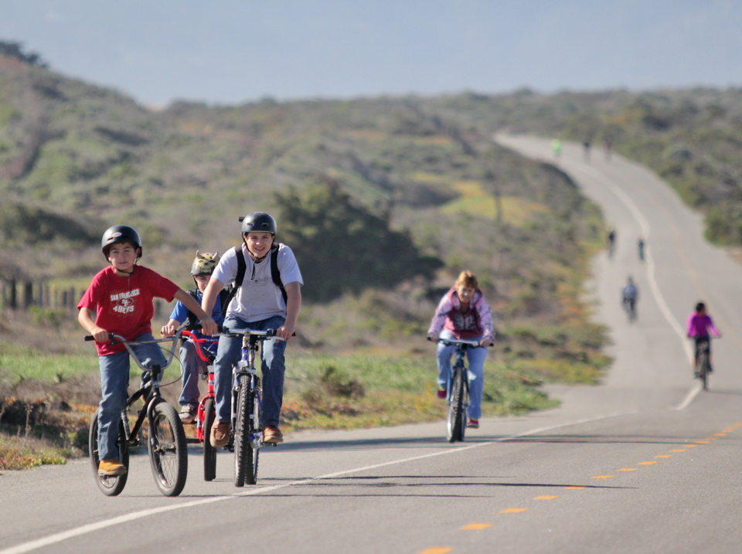
Existing trail use in our region

Slide 3
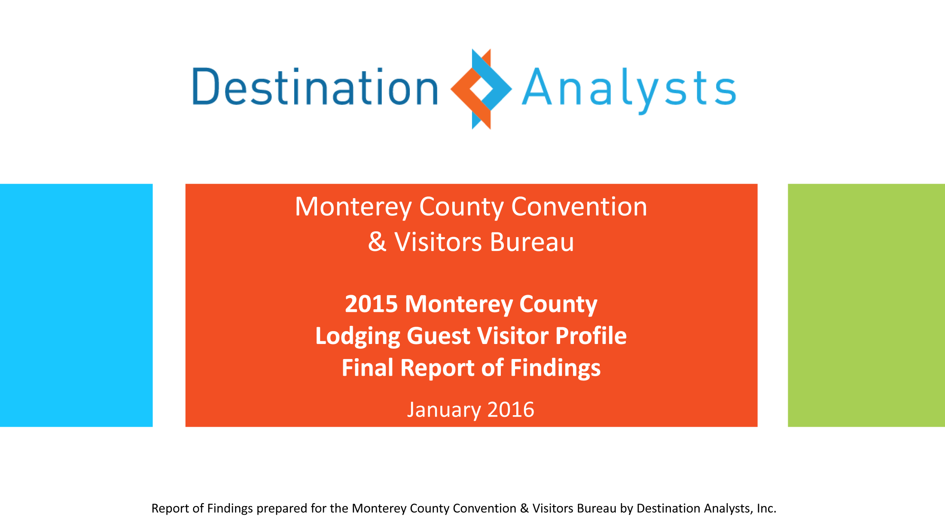

Slide 4
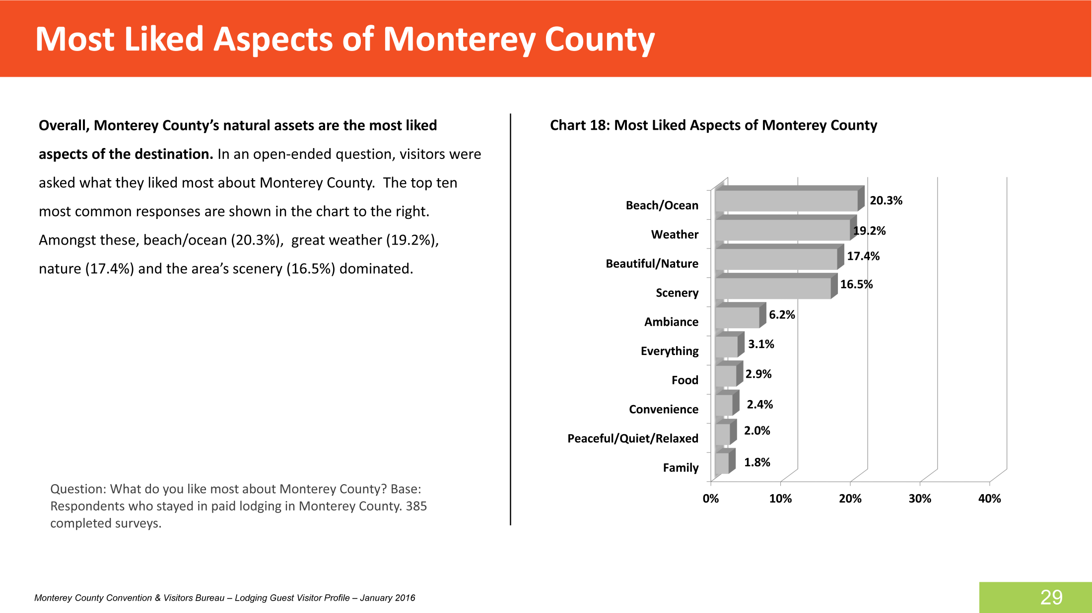

Slide 5
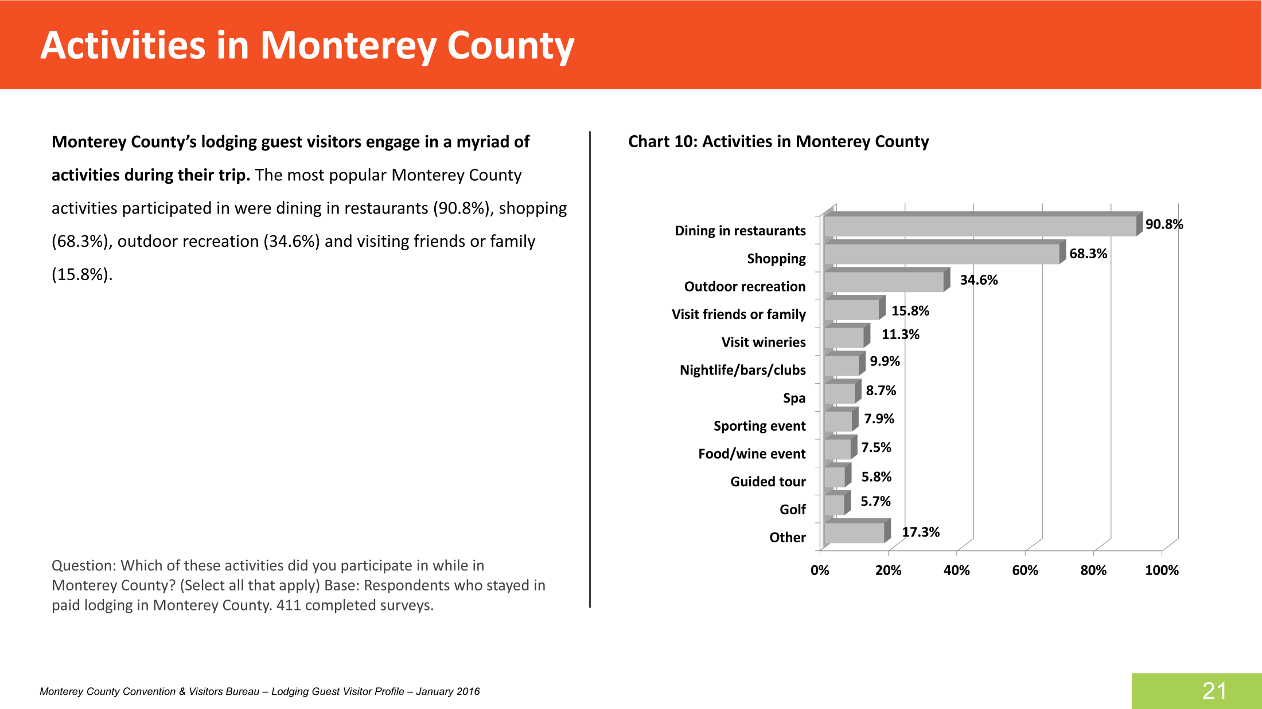

Slide 6
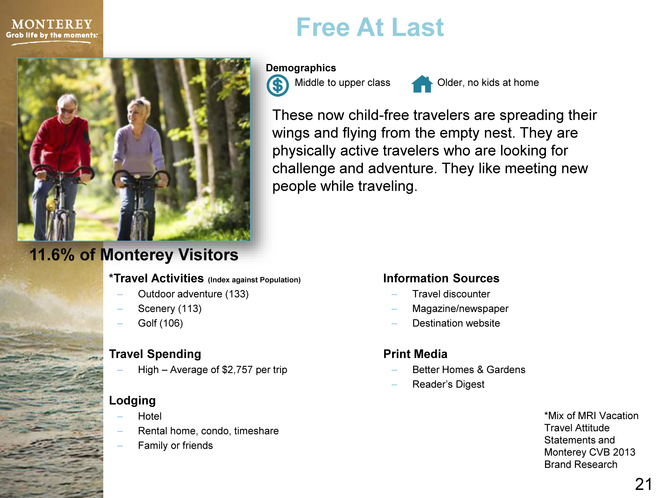

Slide 7
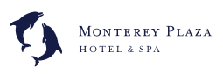
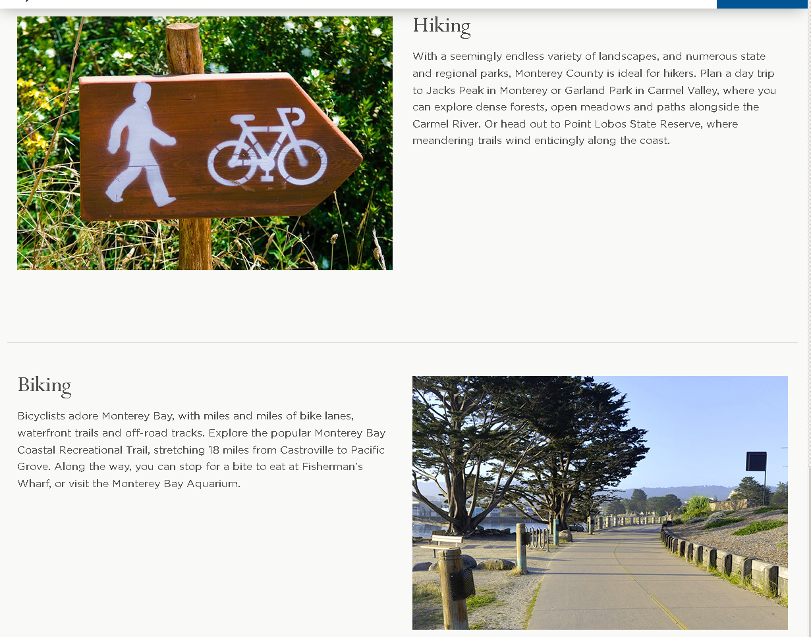

Slide 8
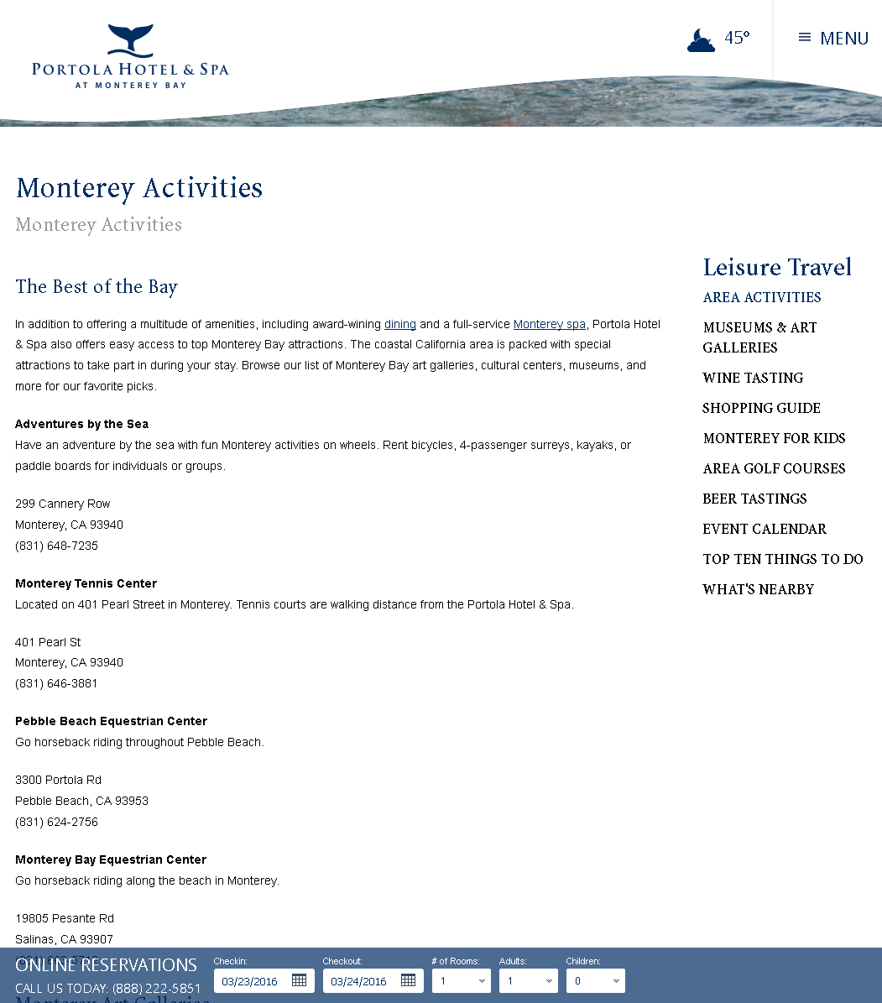

Slide 9
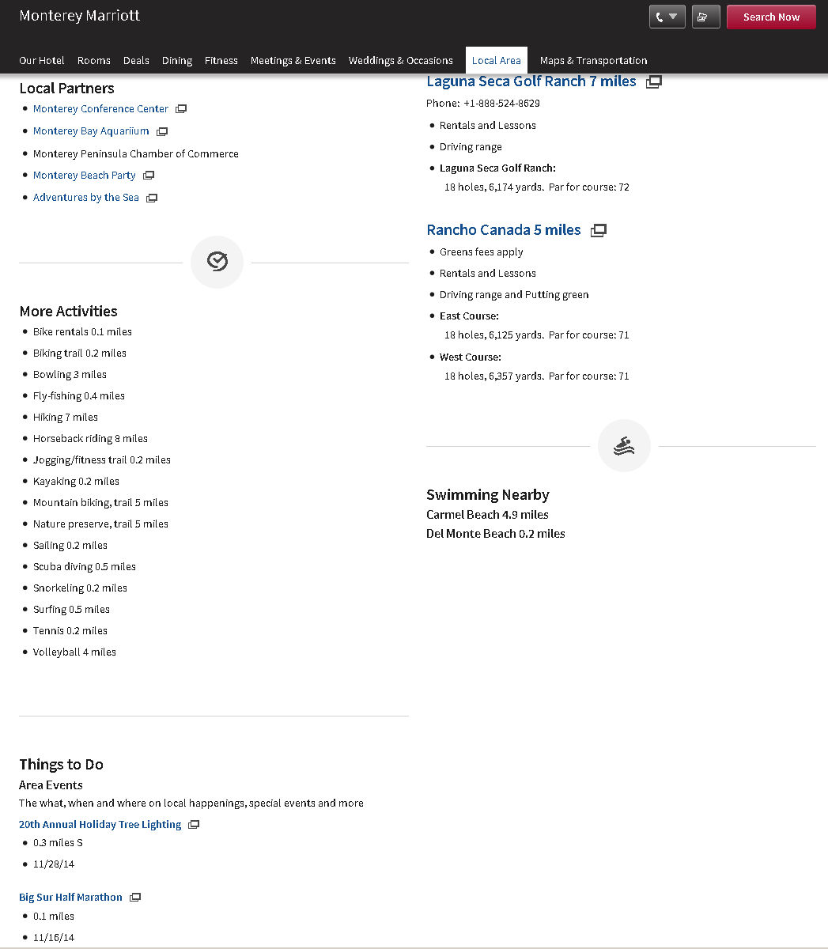

Slide 10
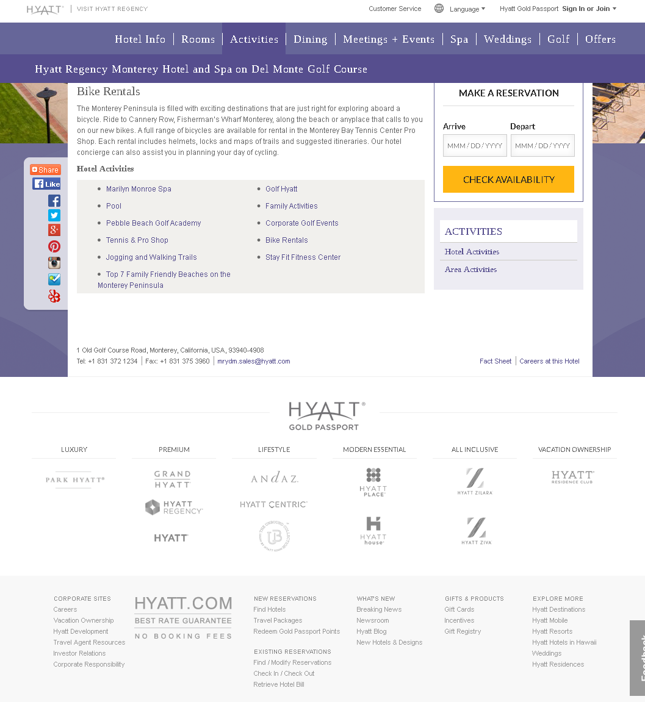

Slide 11
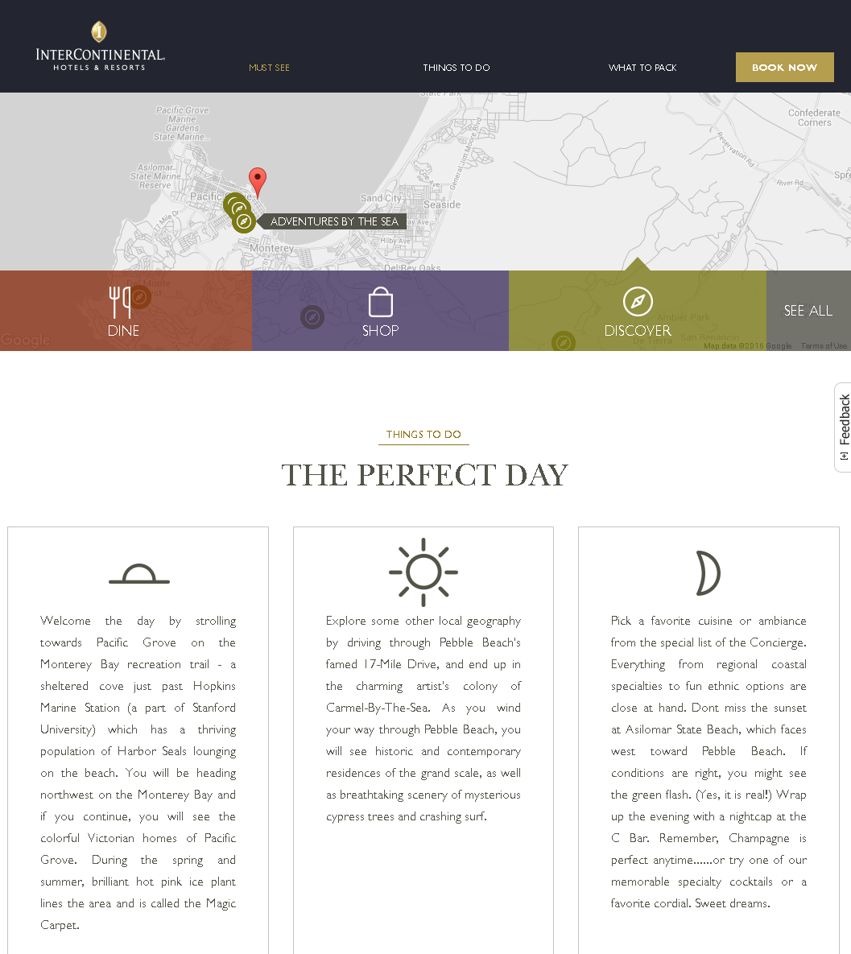

Slide 12
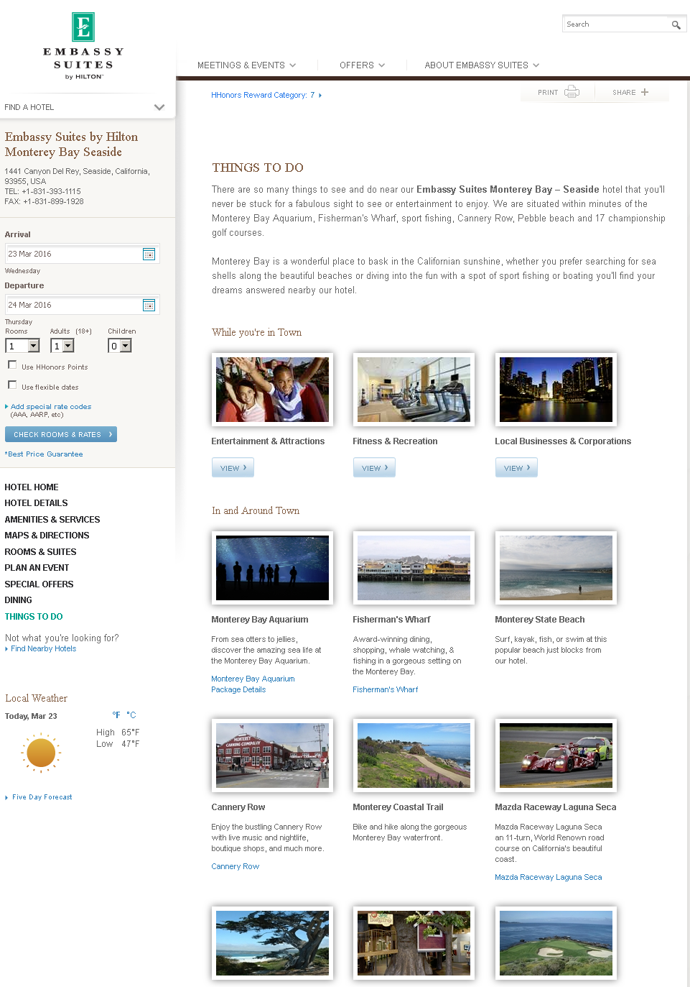

Slide 13
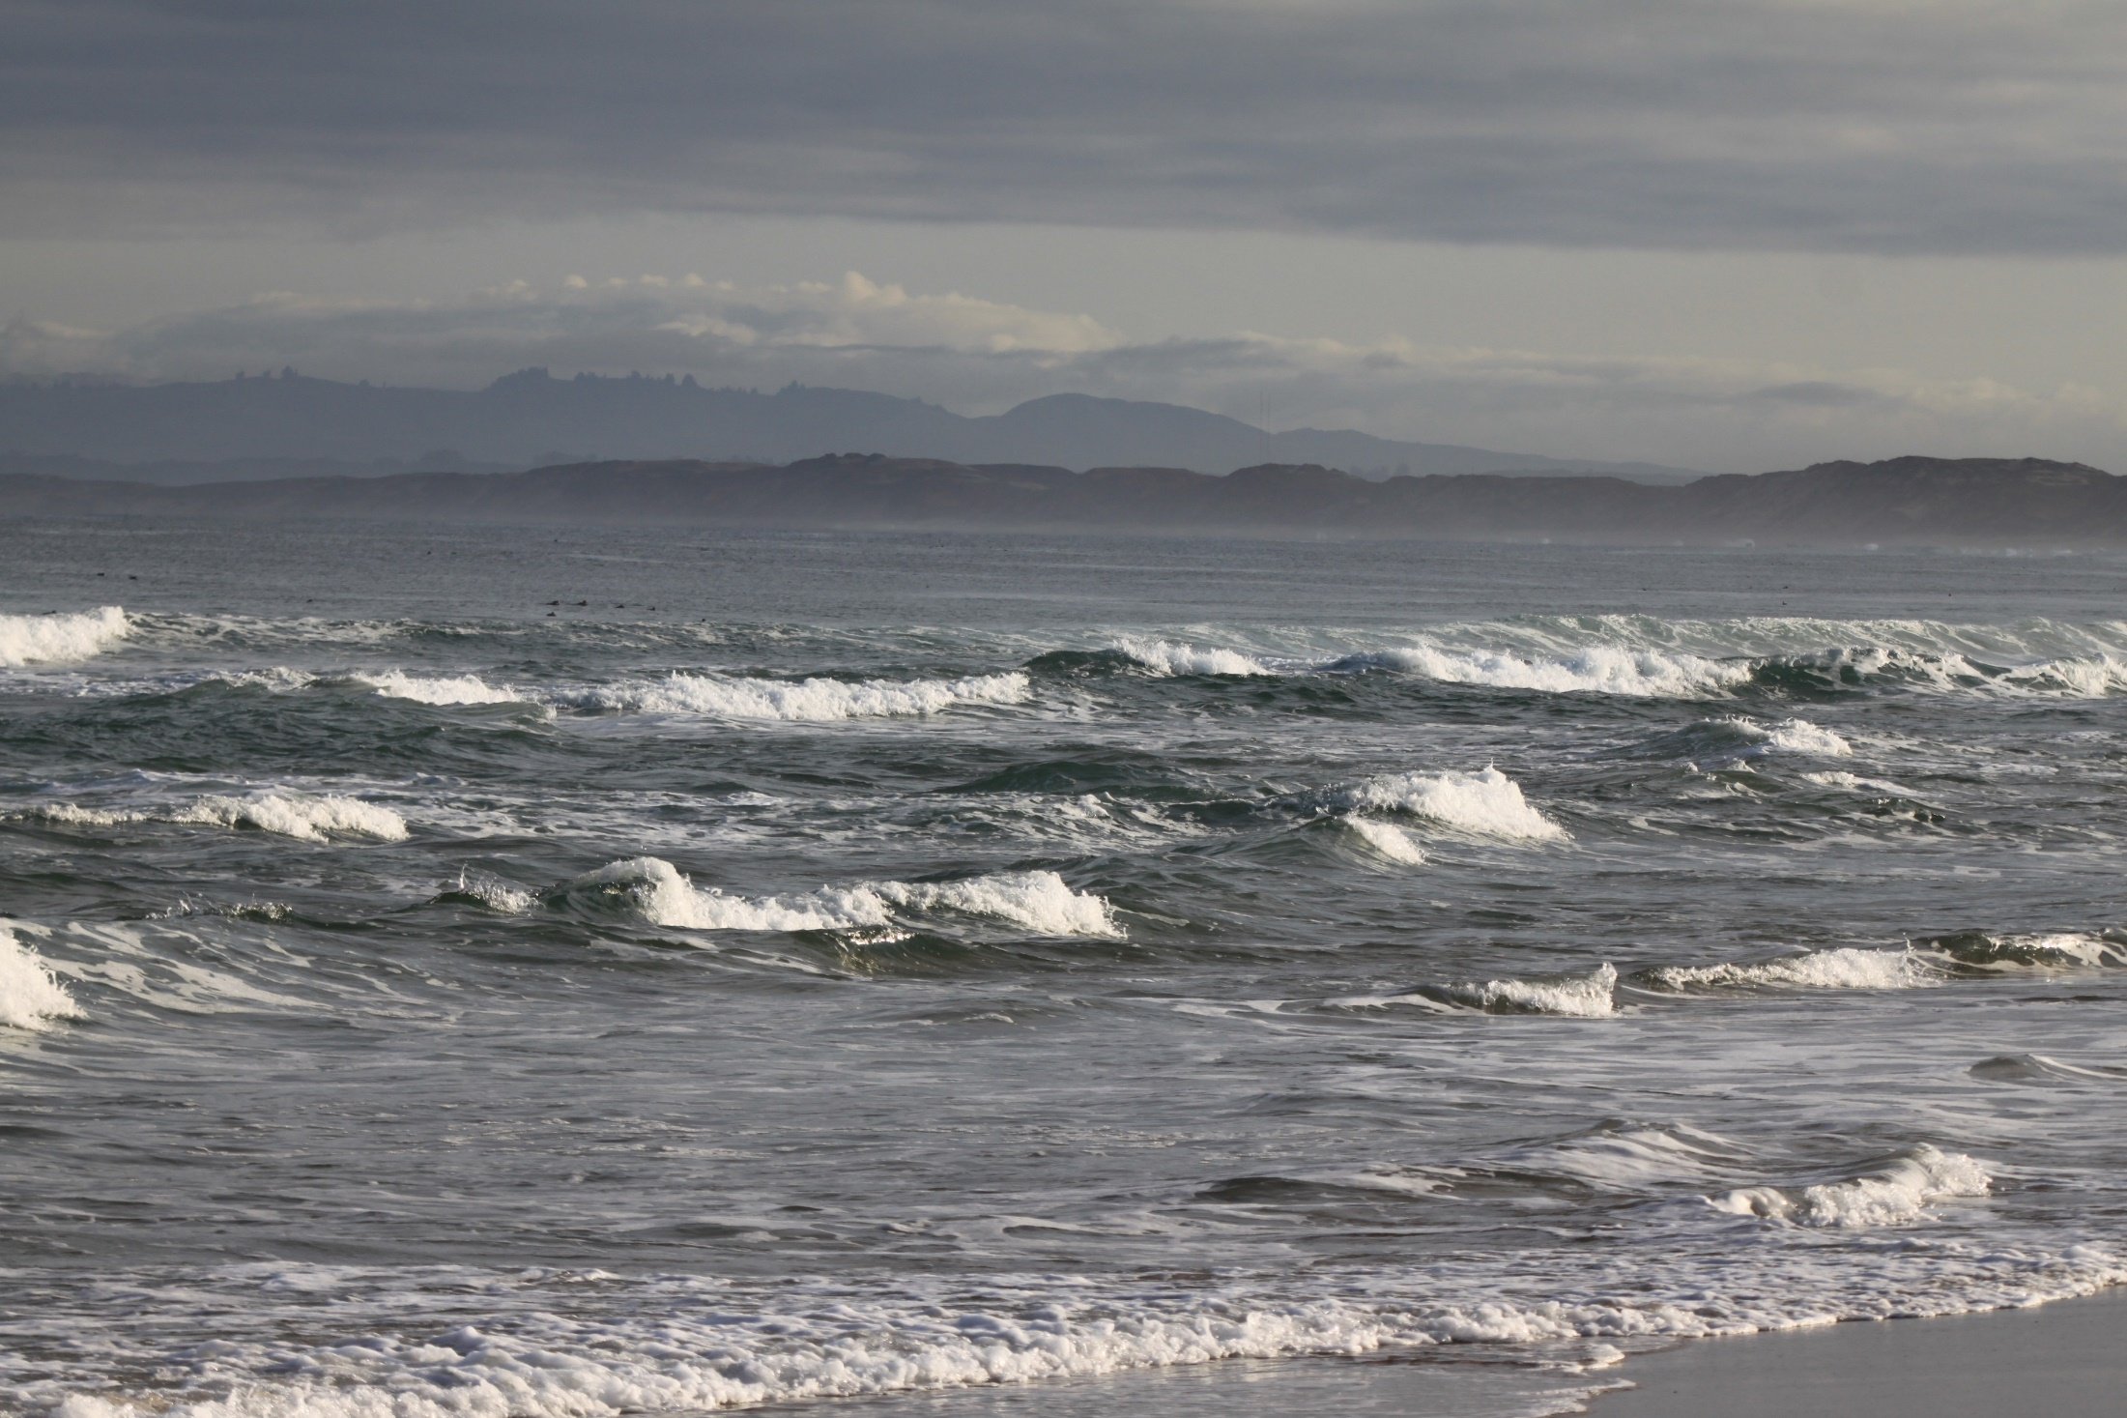

Slide 14
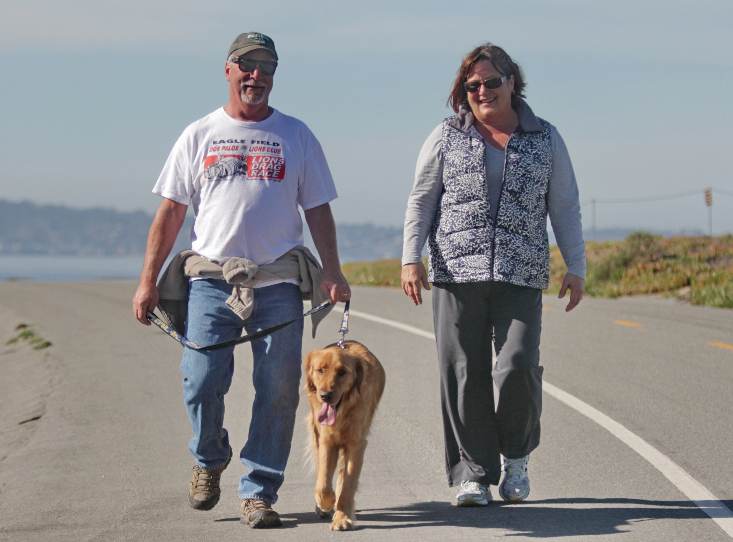

Slide 15
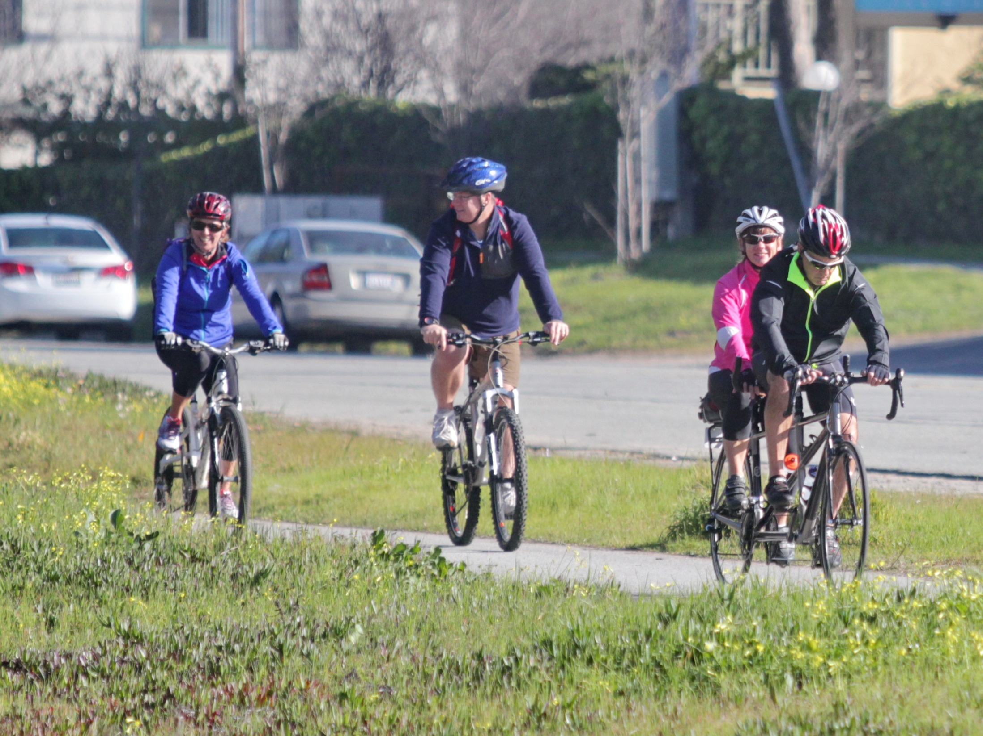

Slide 16
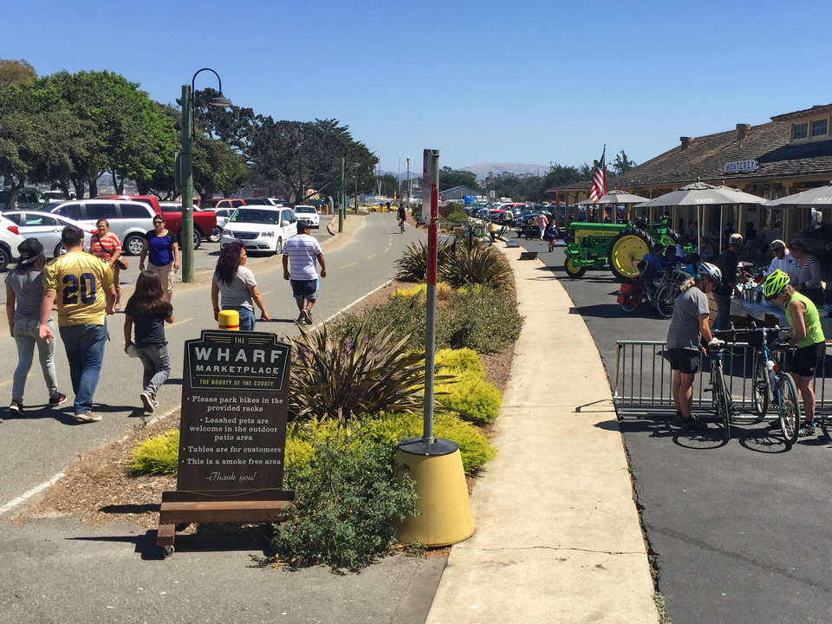
Example of what a multi-use trail can be like
when it combines with a dense developed landscape:
the new Wharf Marketplace in Monterey

Slide 17
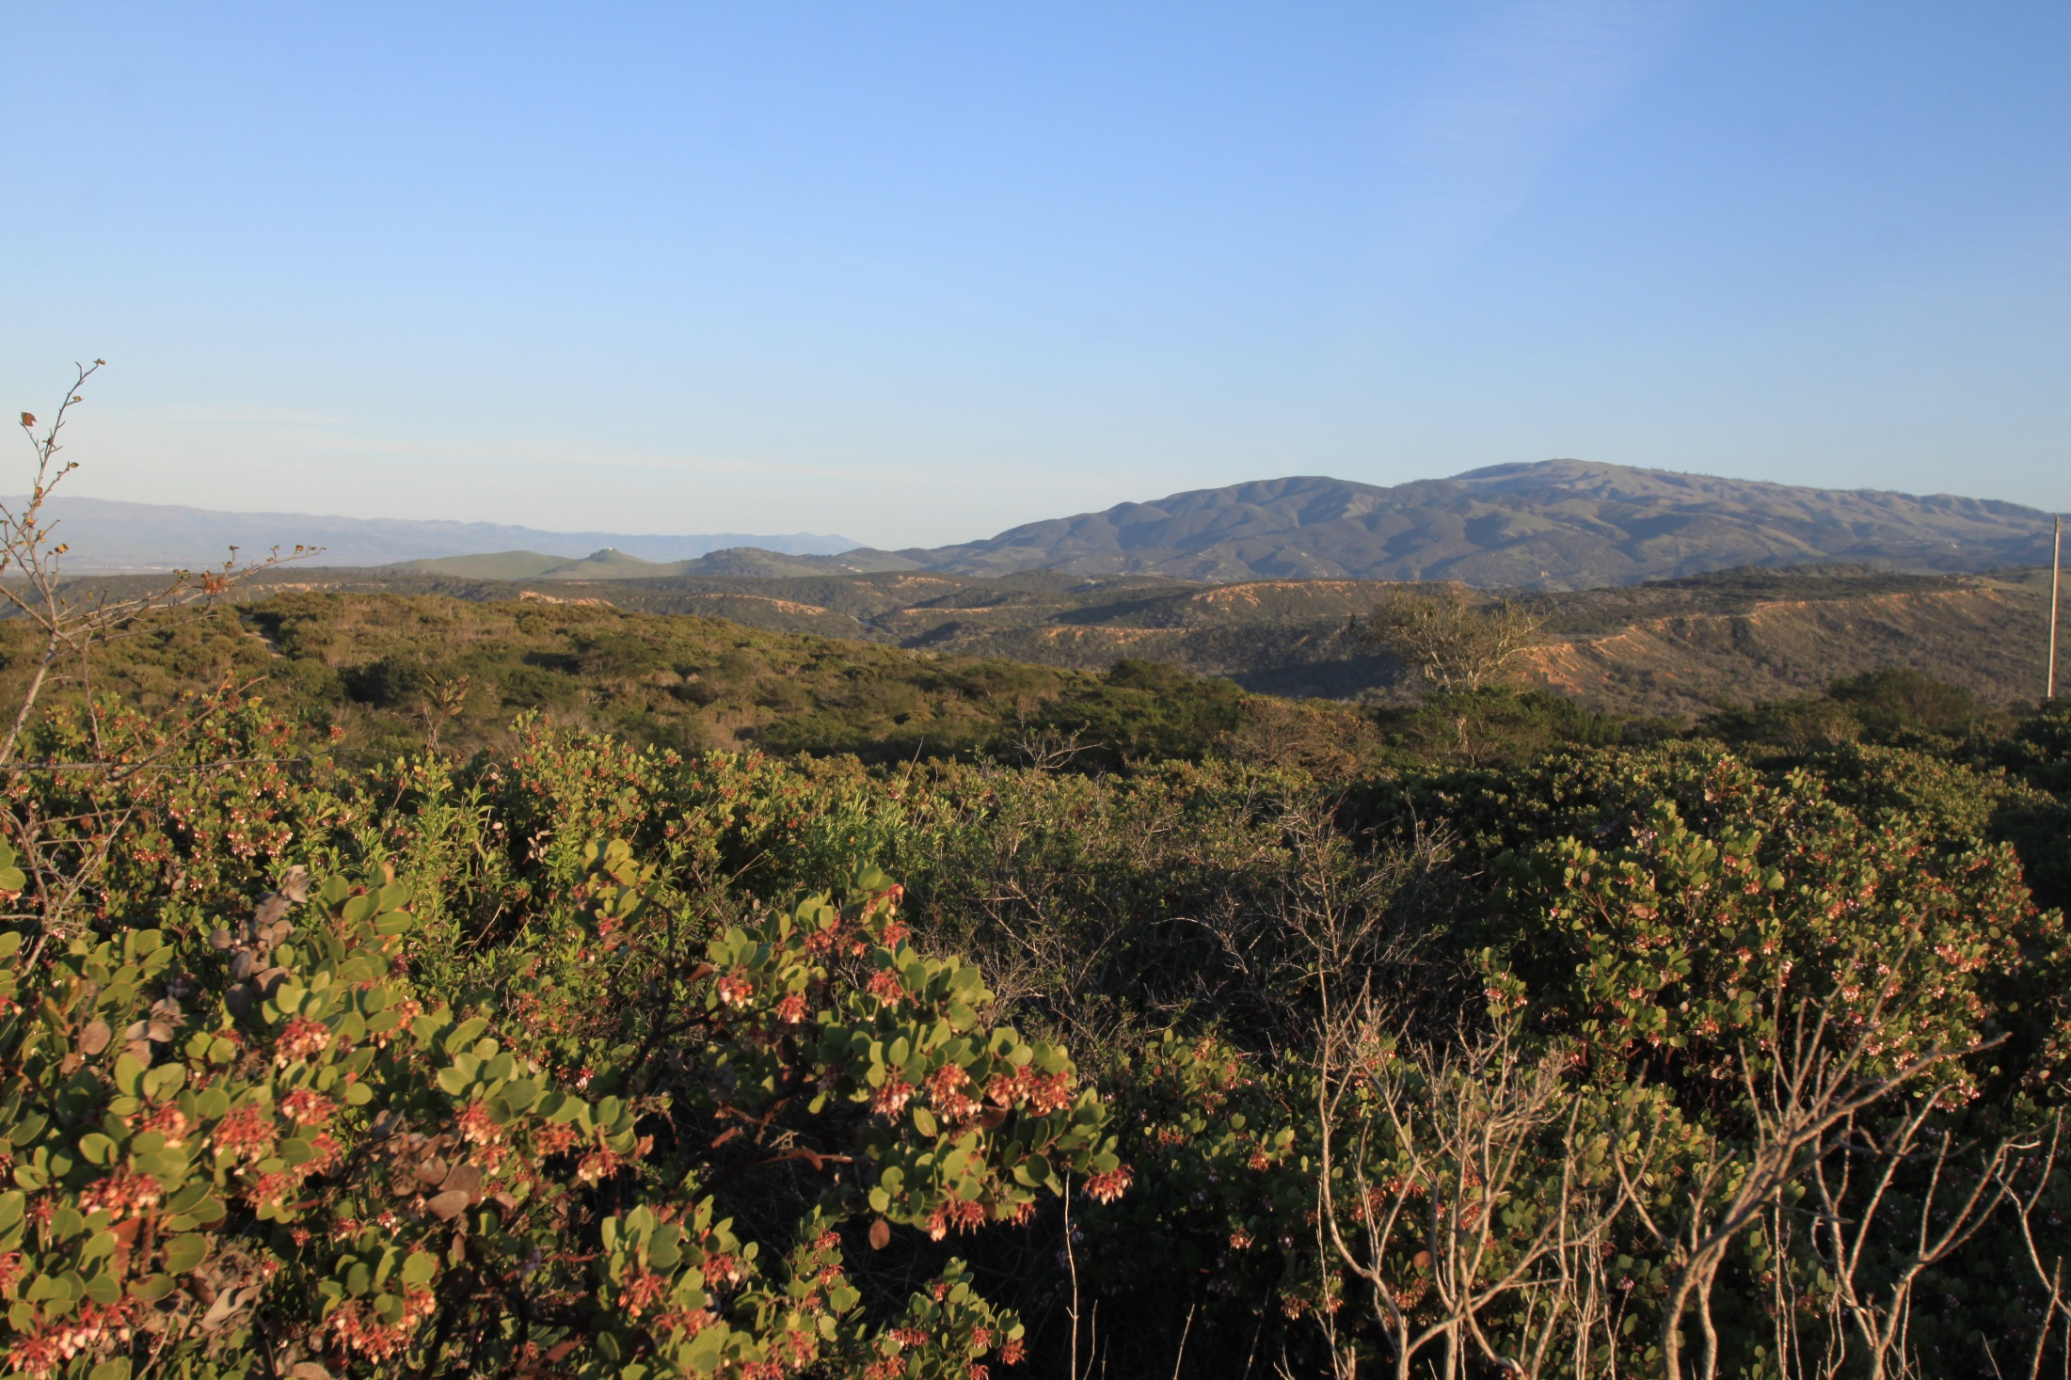

Slide 18
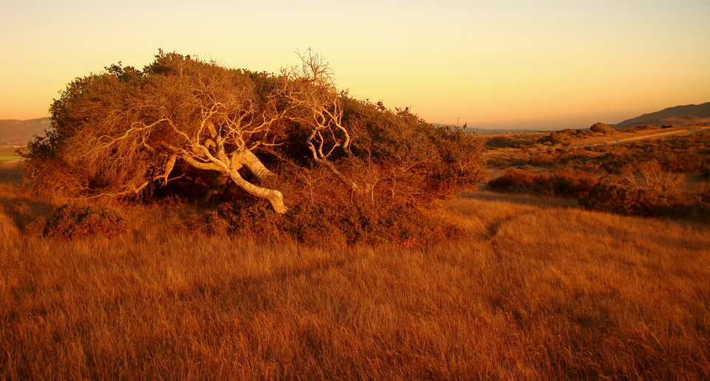

Slide 19
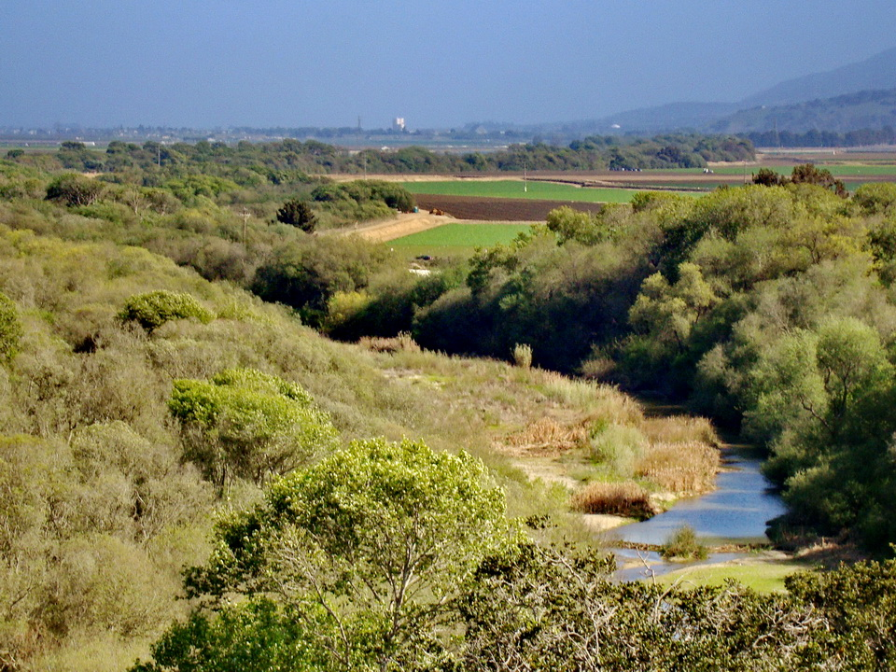

Slide 20
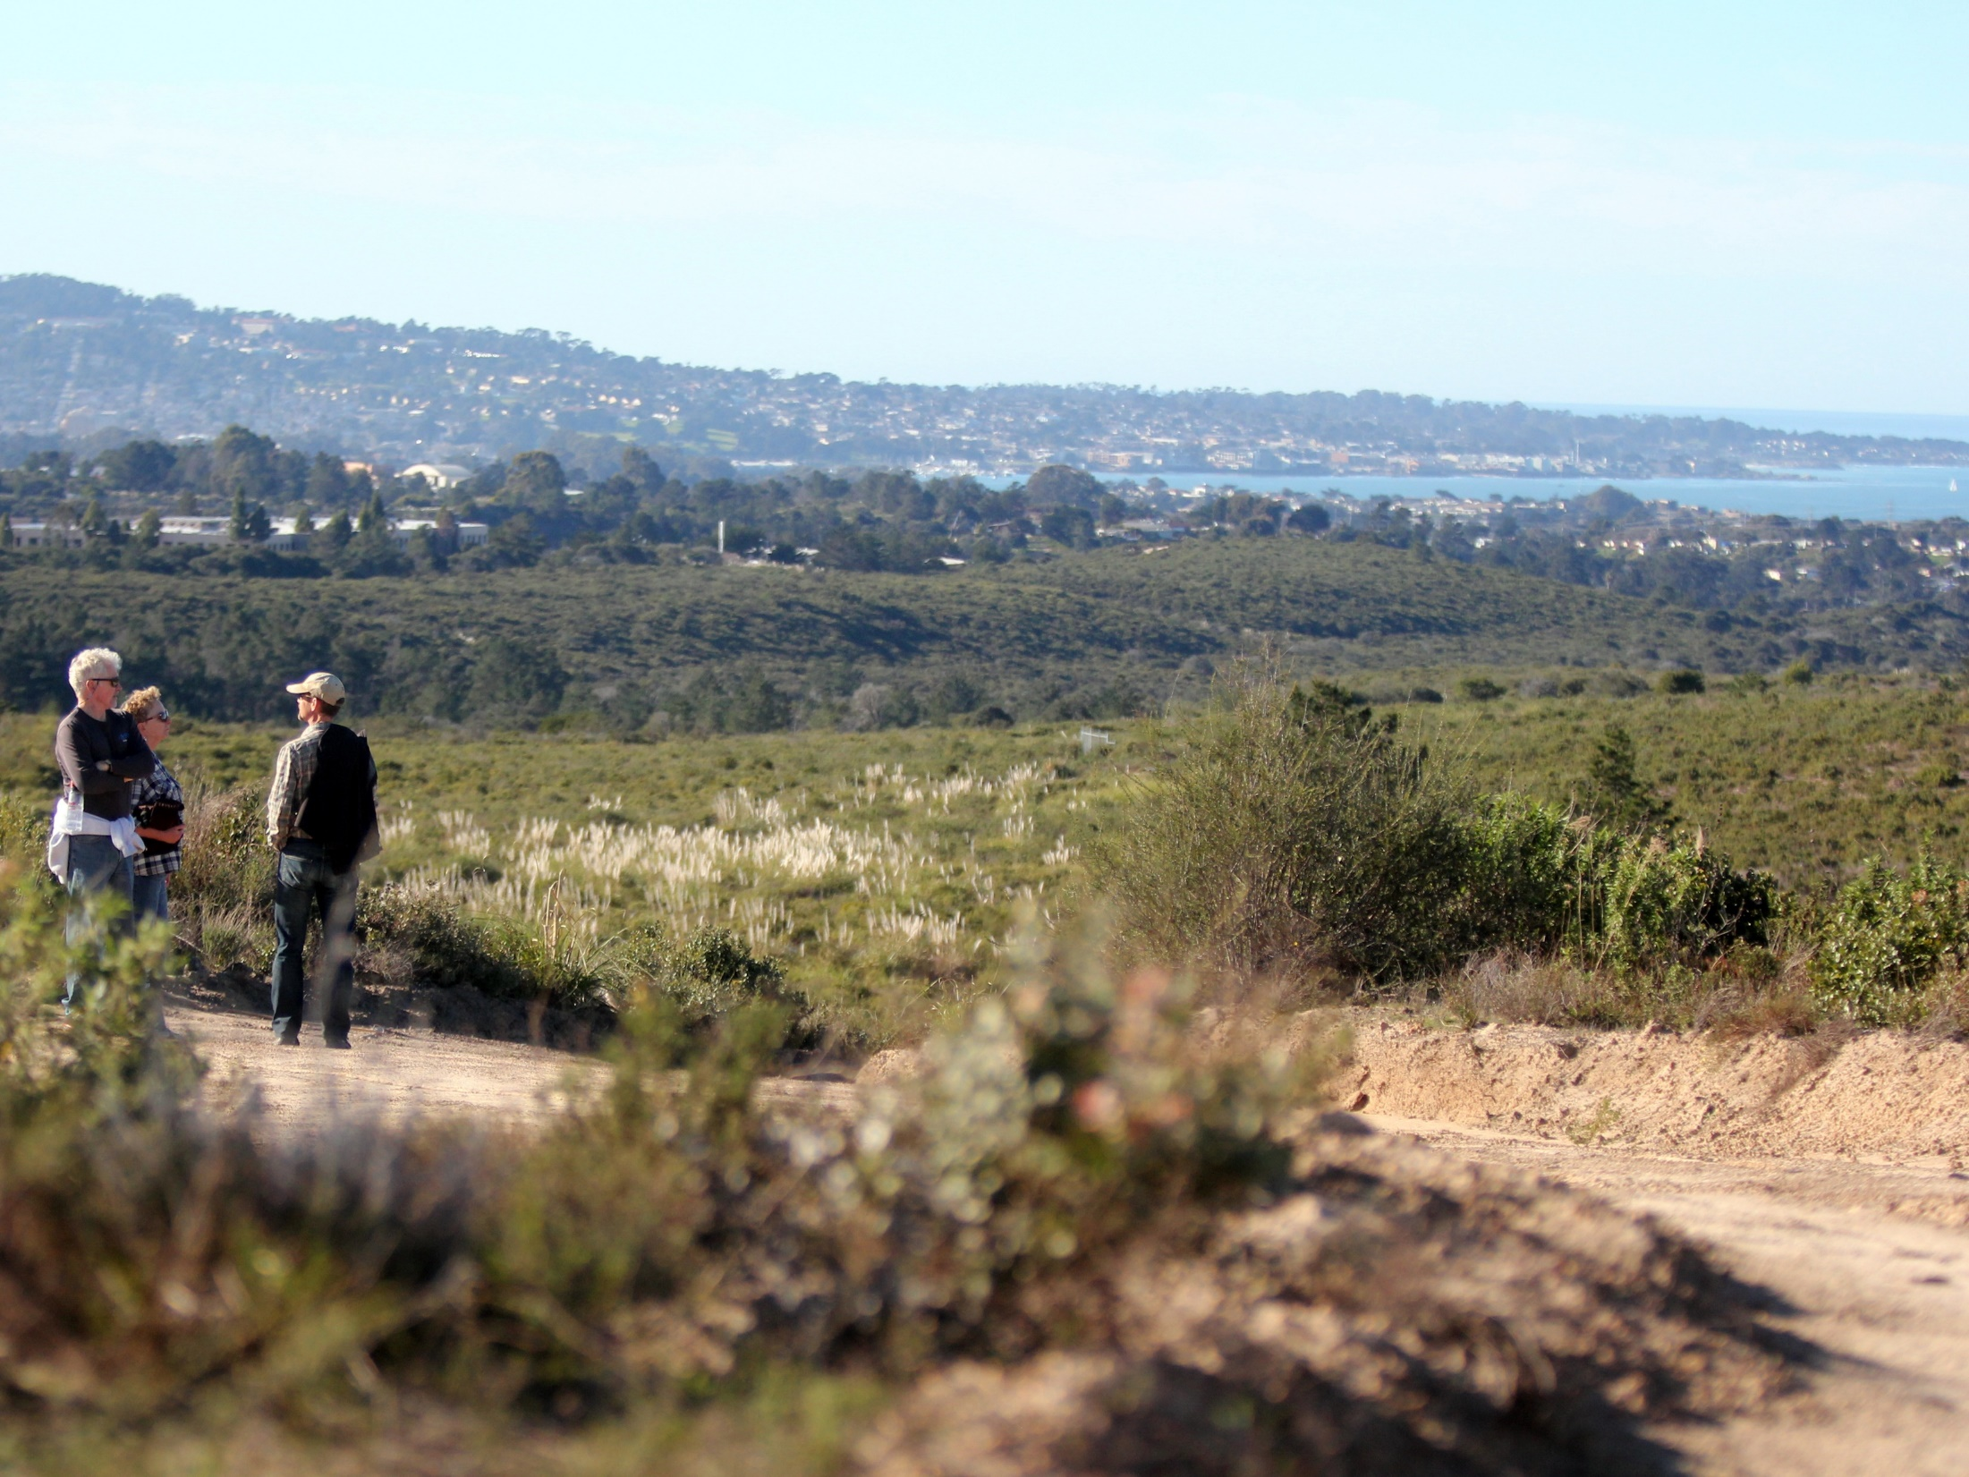

Slide 21
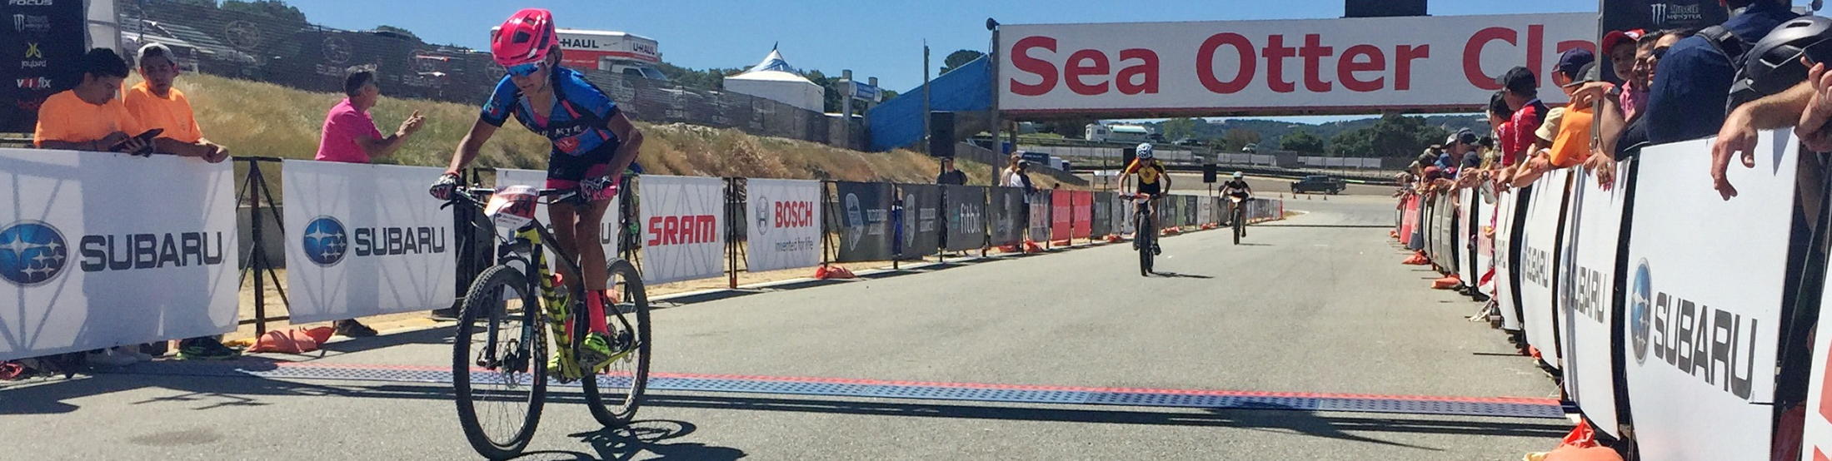
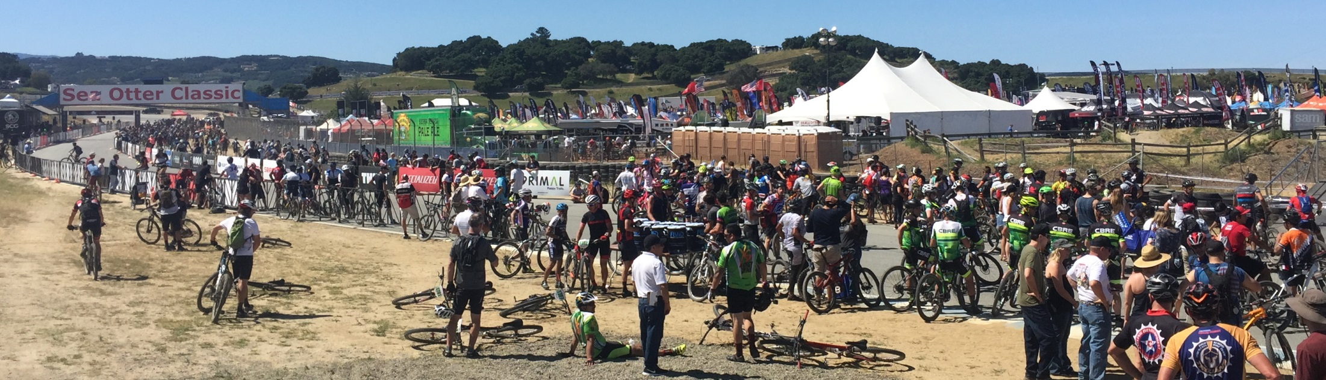
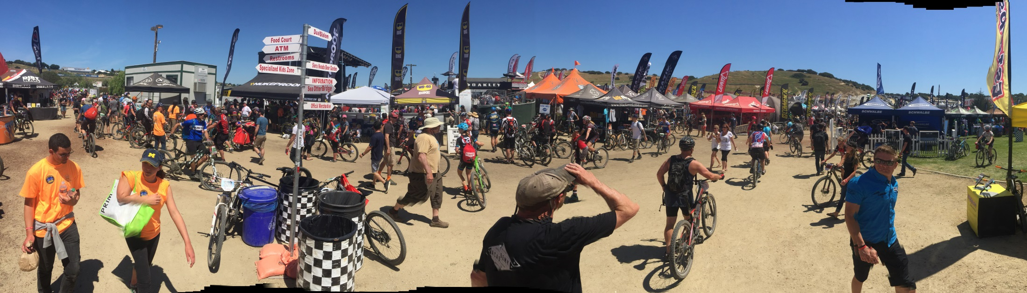

Slide 22
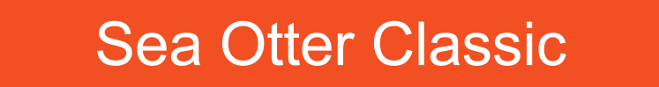
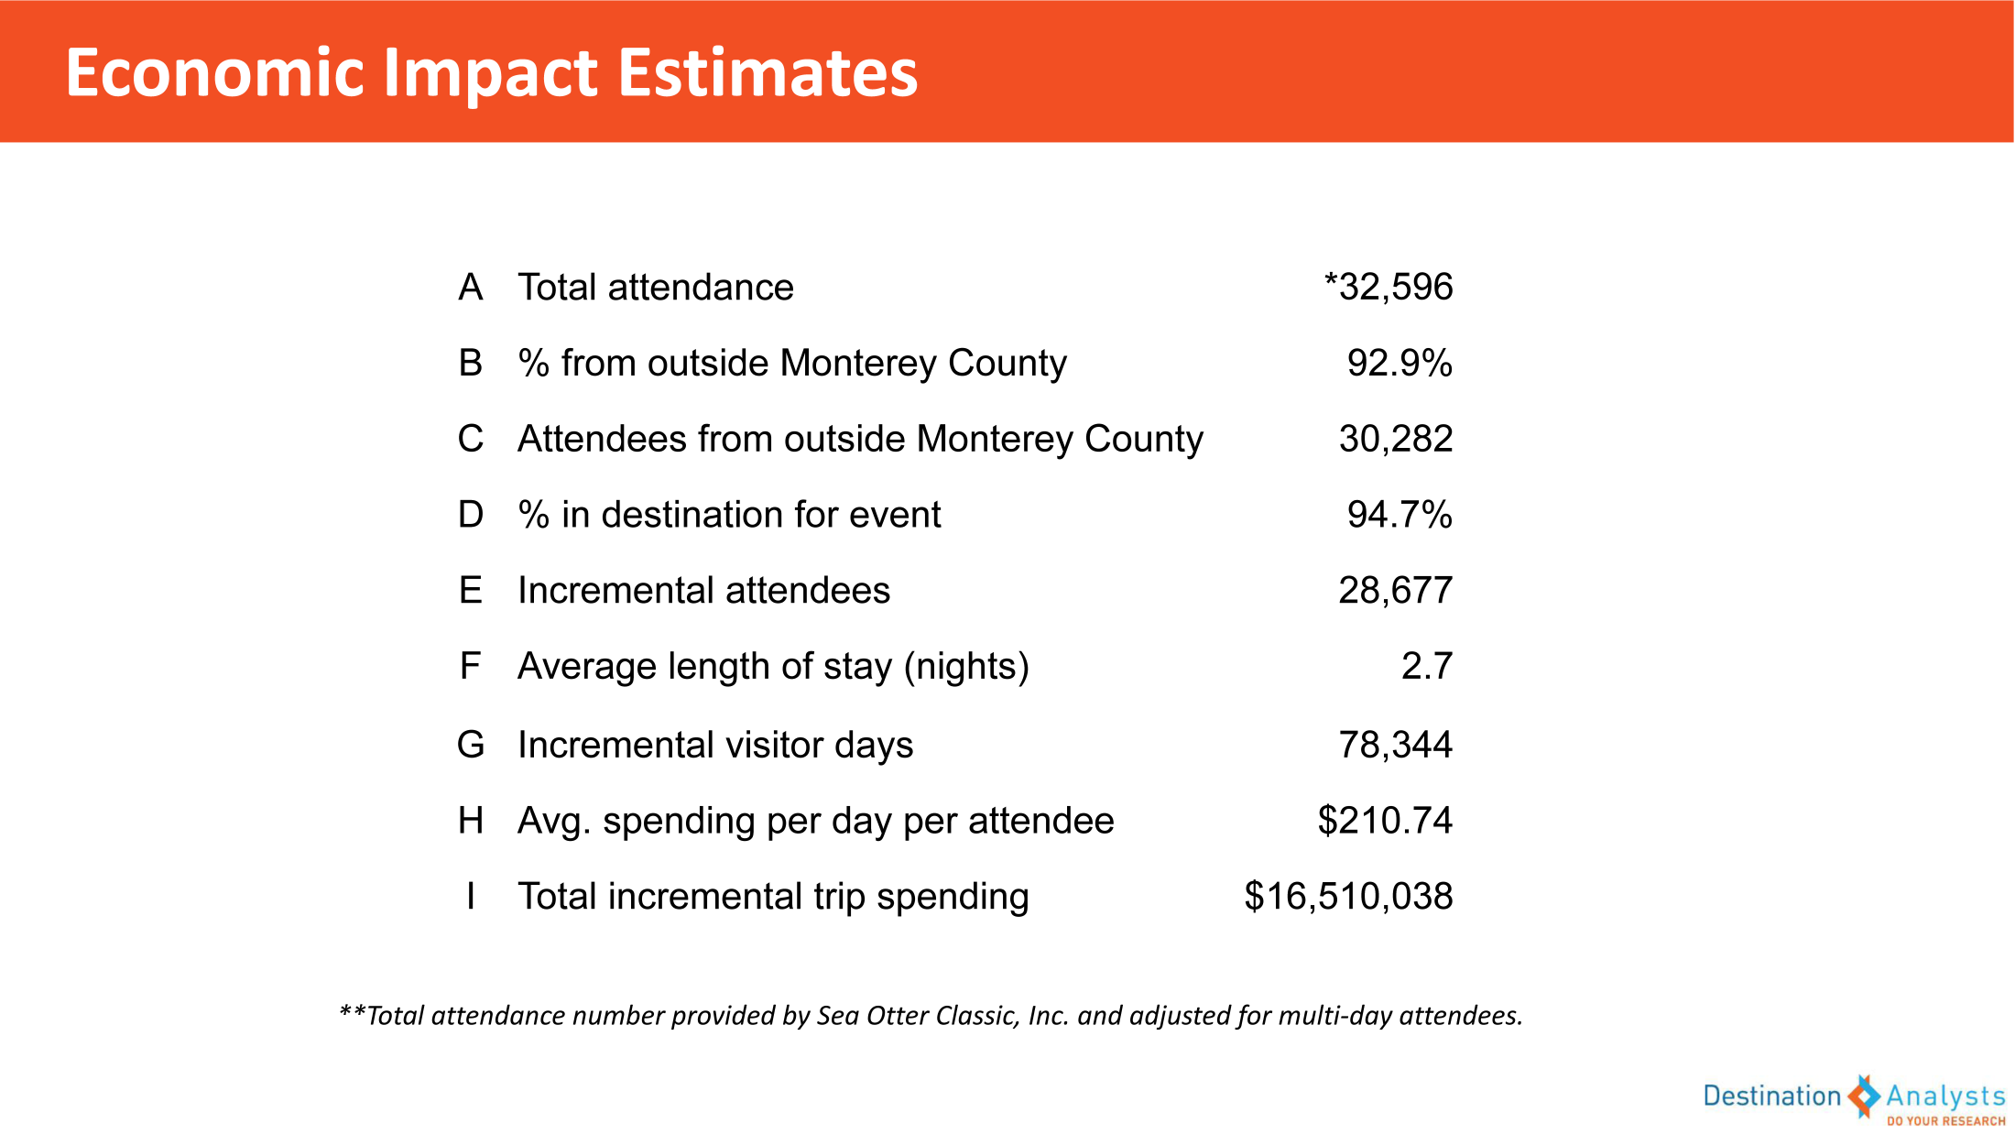

Slide 23
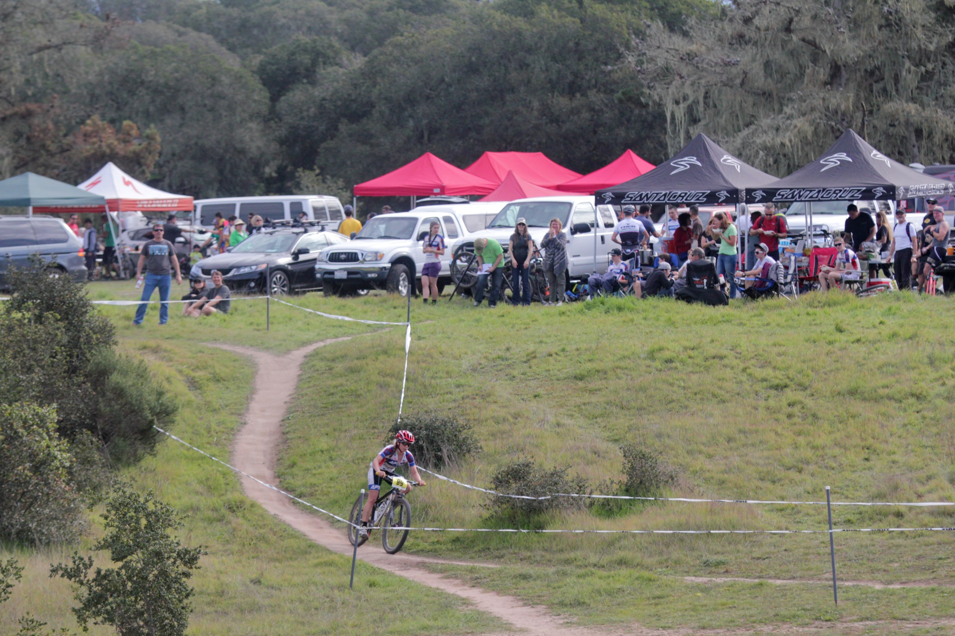
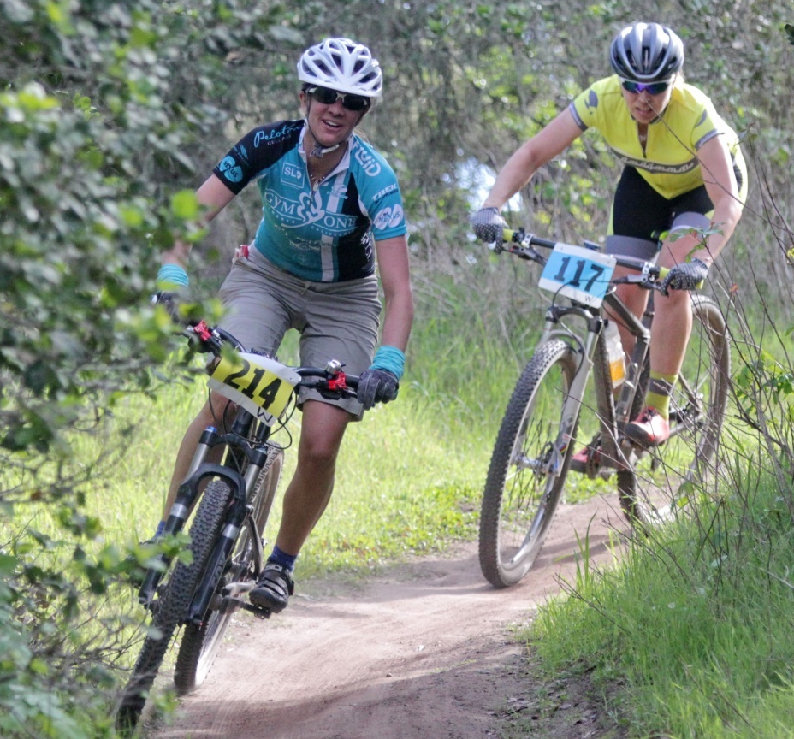

Slide 24
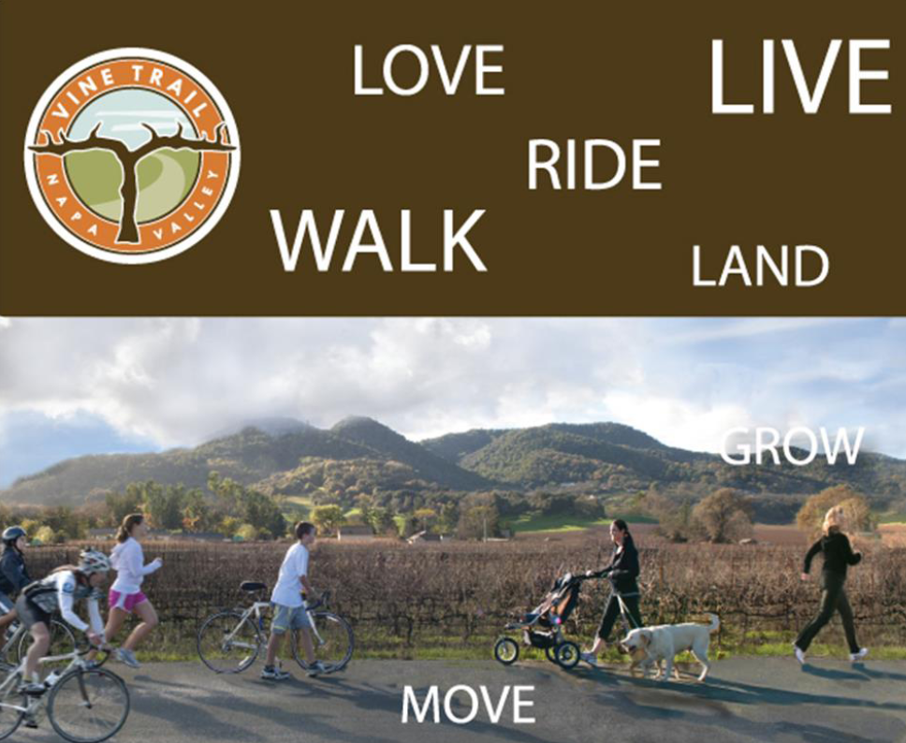

Slide 25
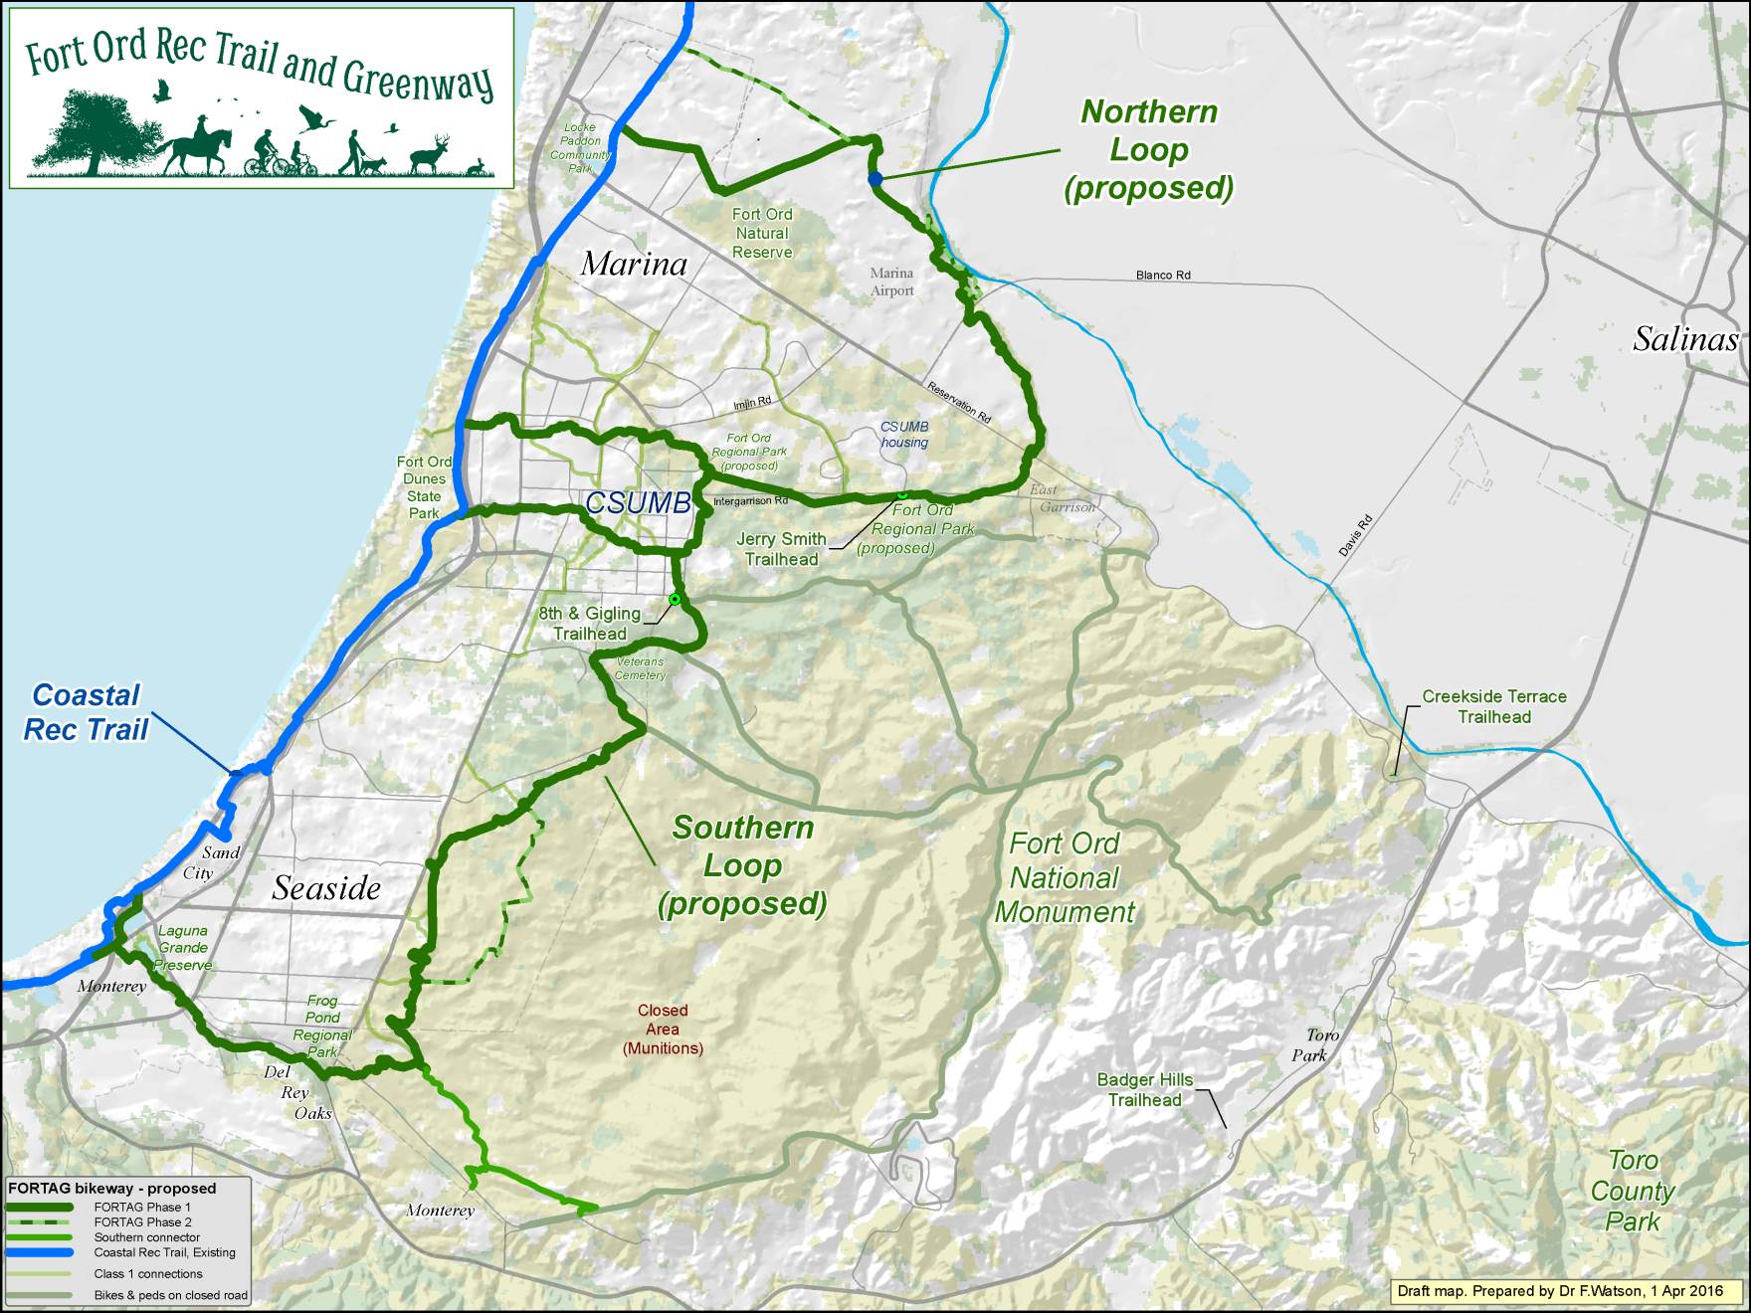
30 miles of paved loops connecting communities to and through open space

Slide 26
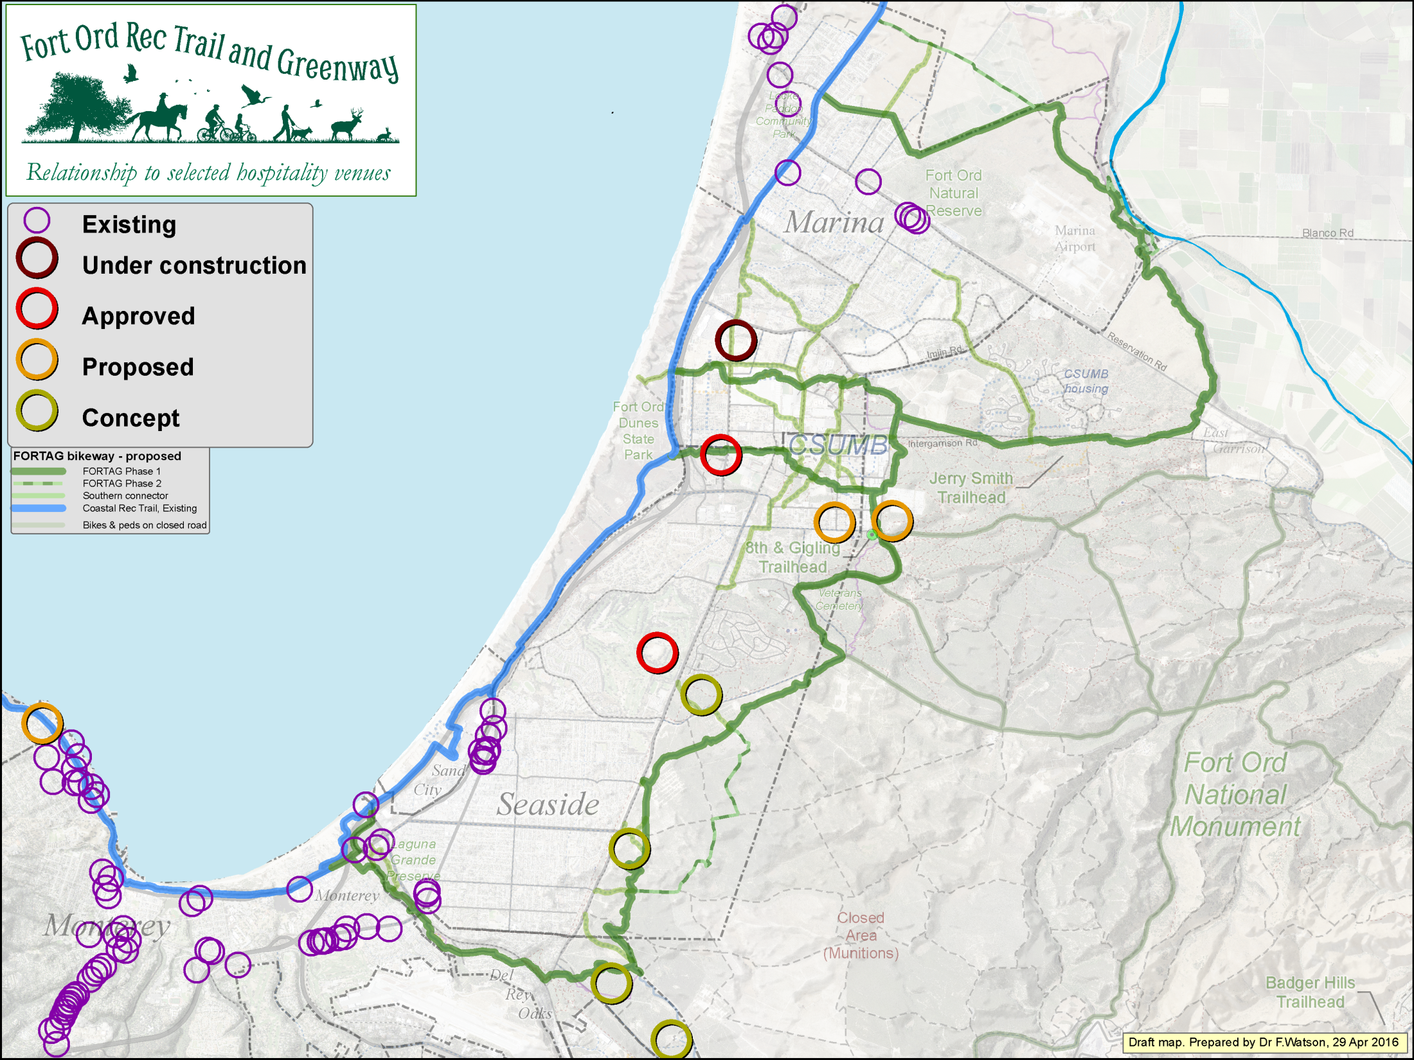

Slide 27
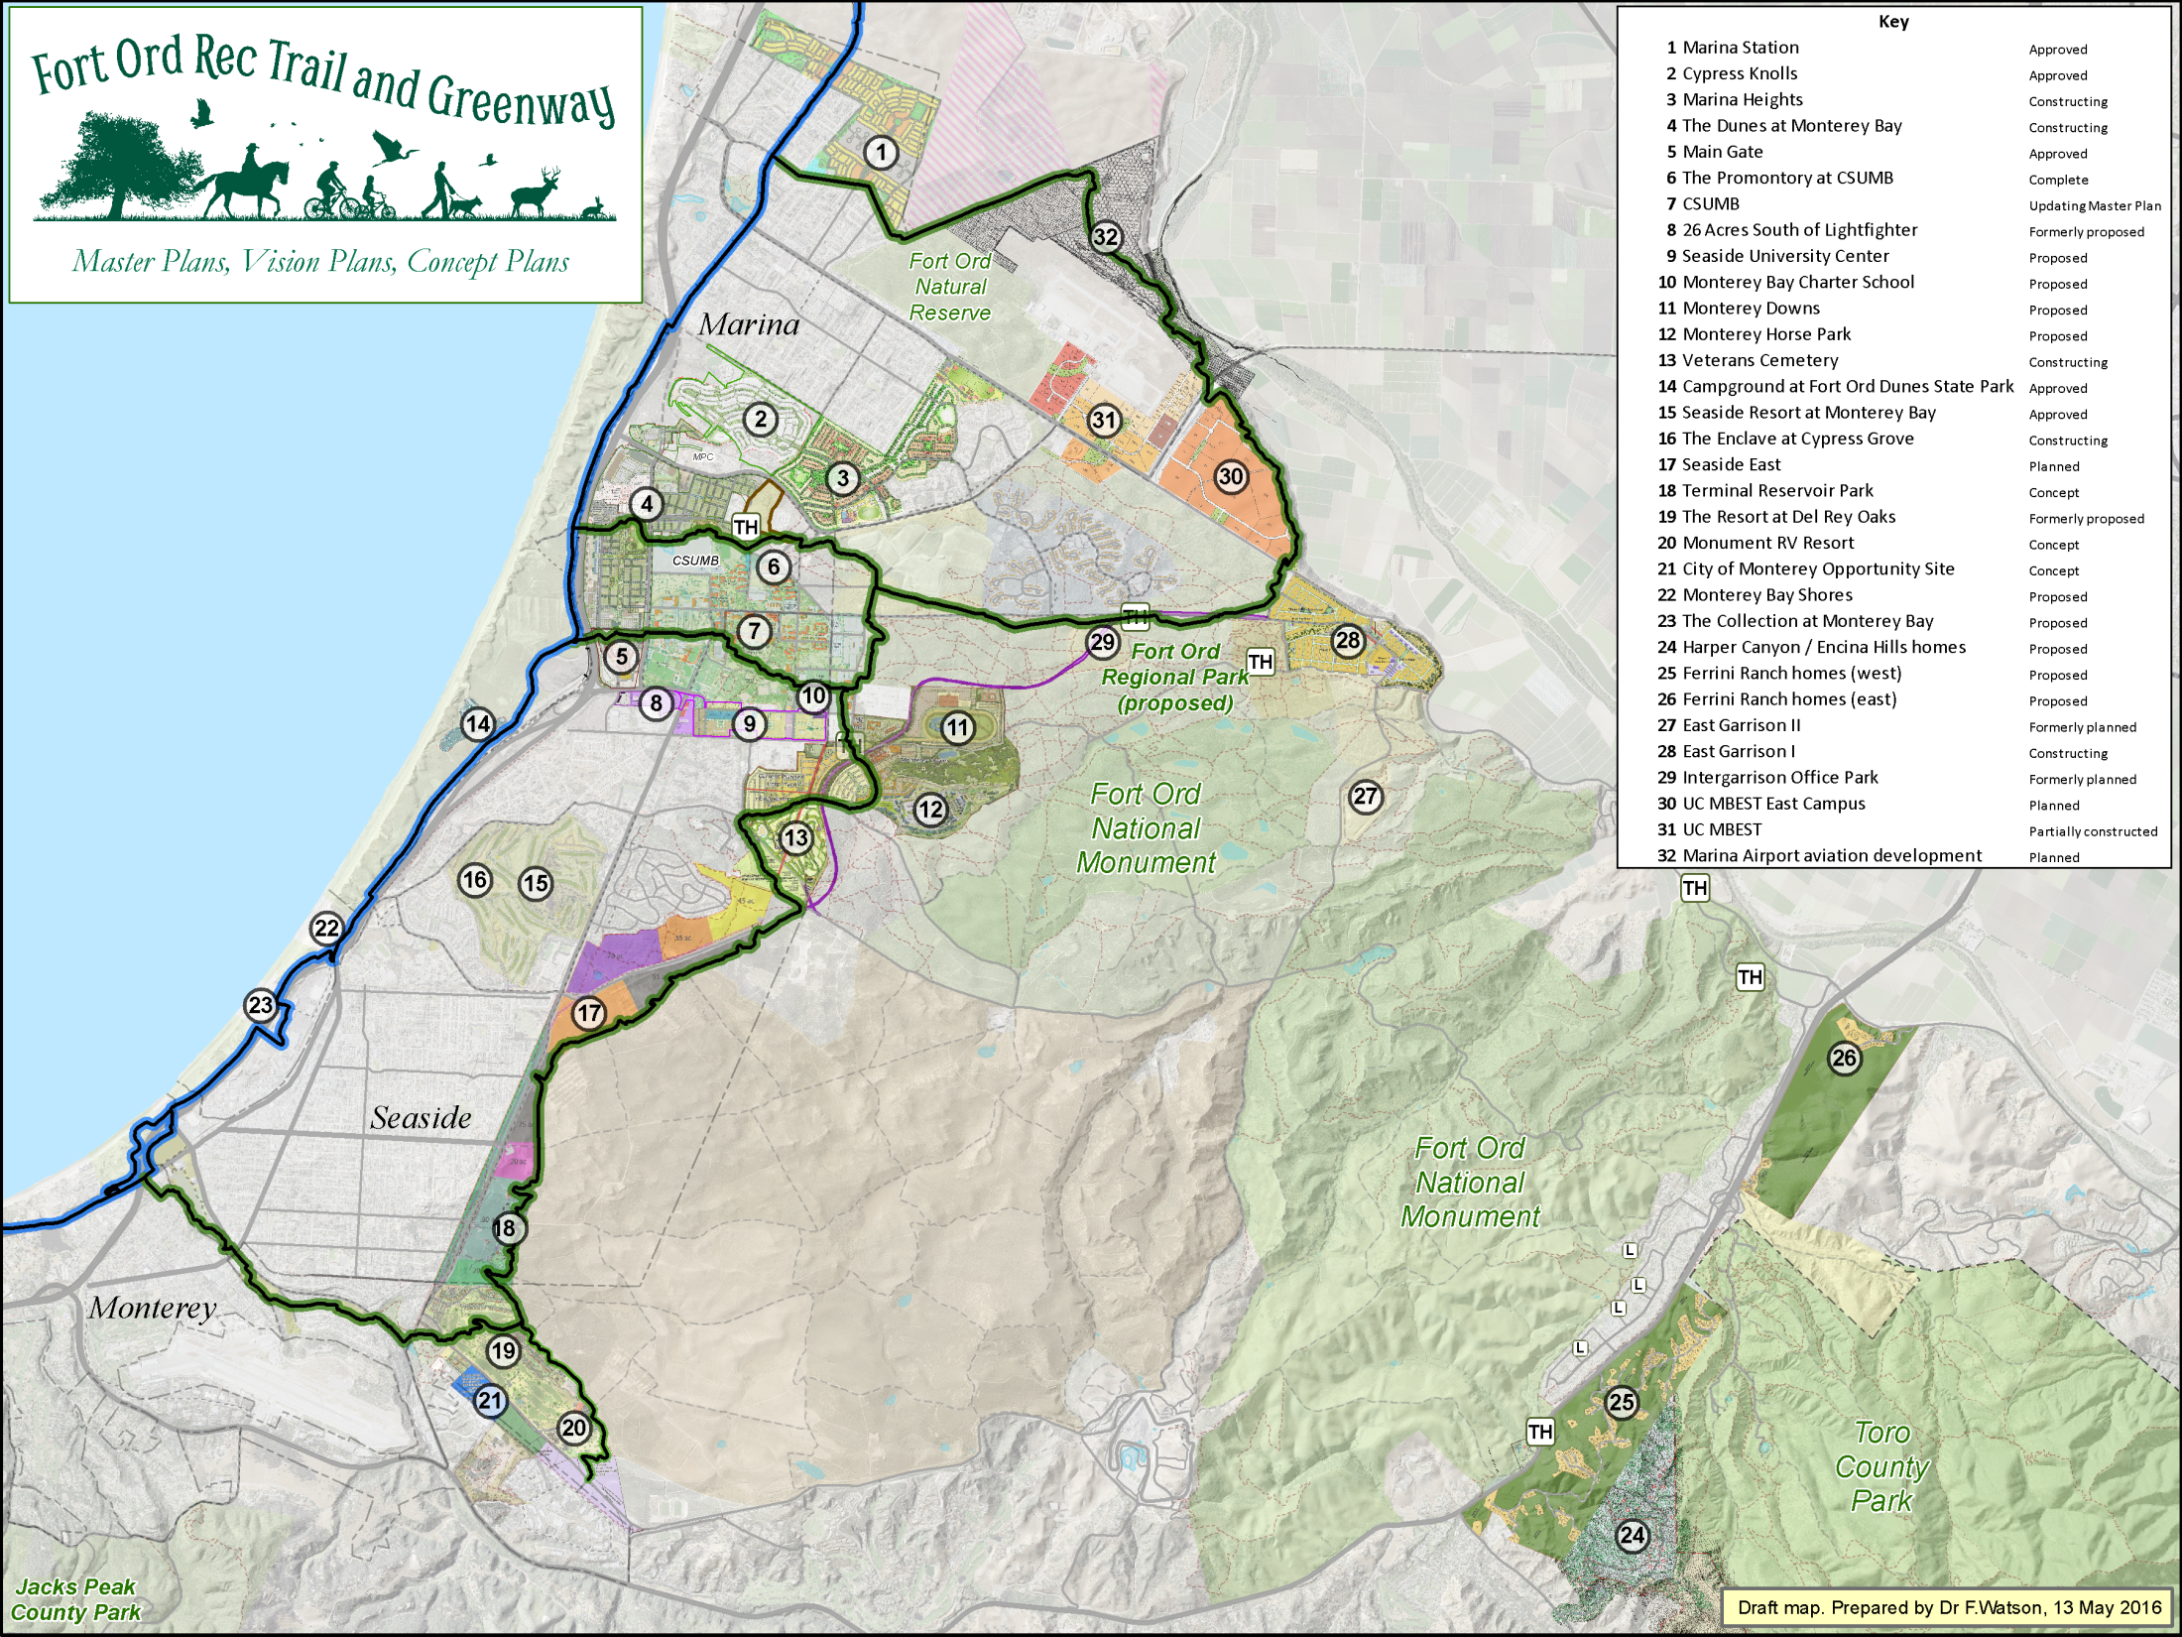
“12-ft Paved Regional Hiker/Biker Trails” are in the 1996/7 base reuse plan, but prior to the FORTAG project, they had not achieved any real prominence amidst all the other specific projects proposed for the region.
Same map, but with
FORTAG added.

Slide 28
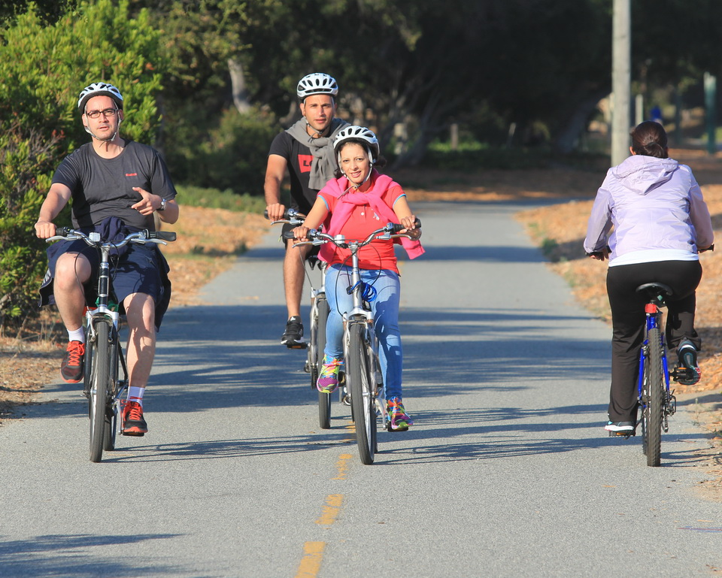
*Formally: “The Monterey Bay Sanctuary Scenic Trail”

Slide 29
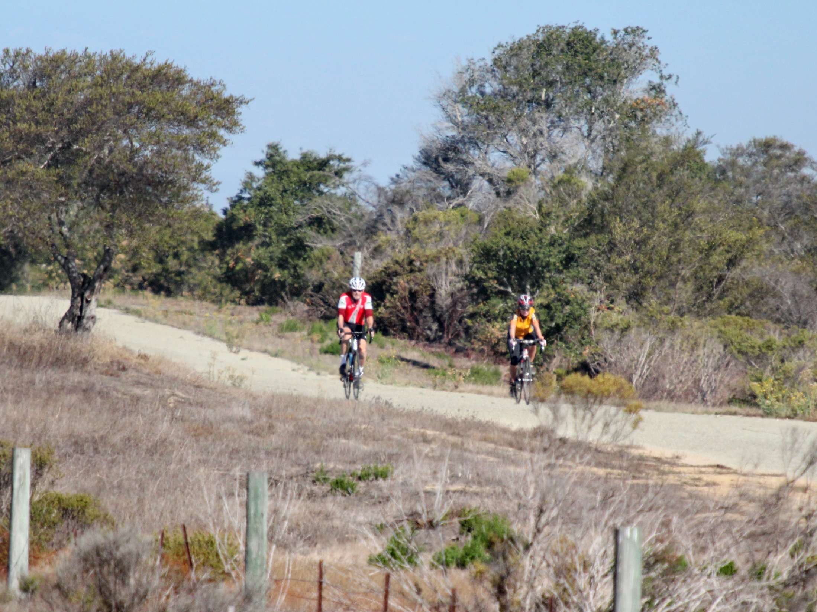

Slide 30
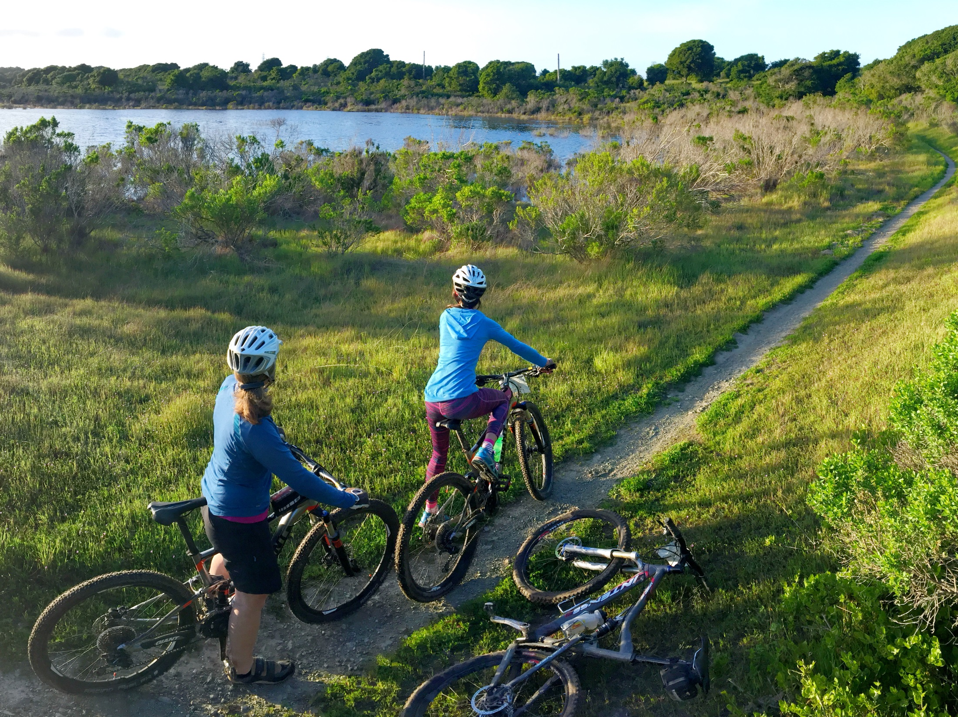
*Formally: “The Monterey Bay Sanctuary Scenic Trail”

Slide 31
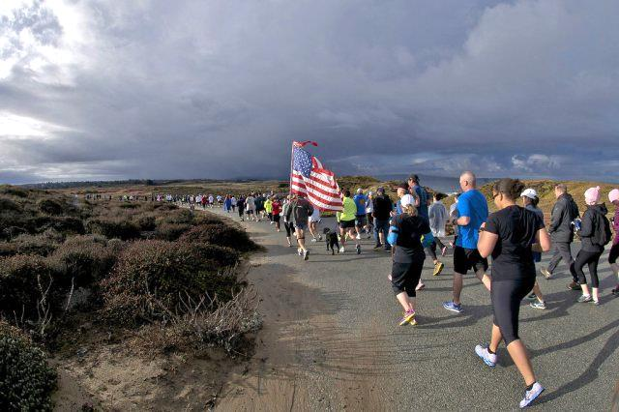

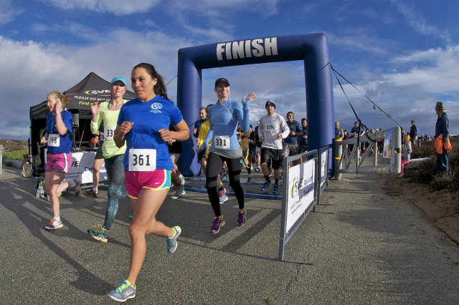
Looped system
for trail events

Slide 32
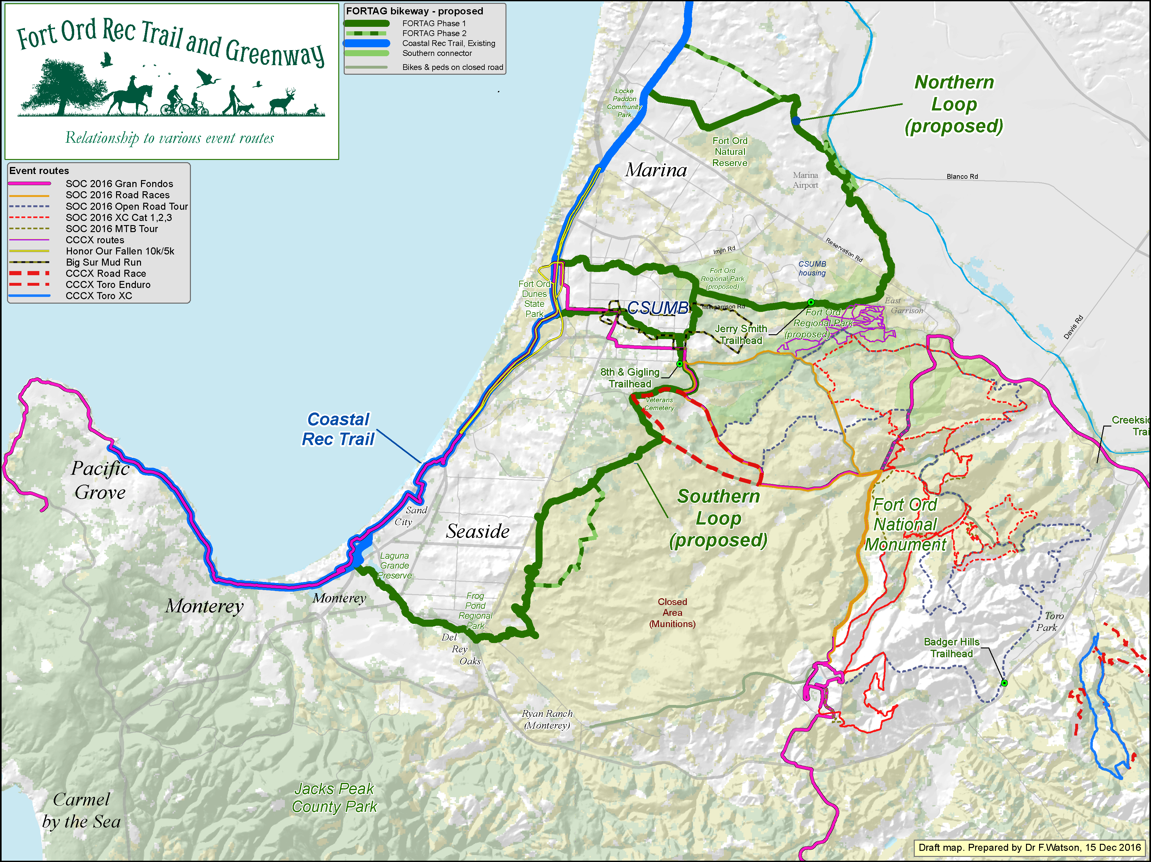

Slide 33
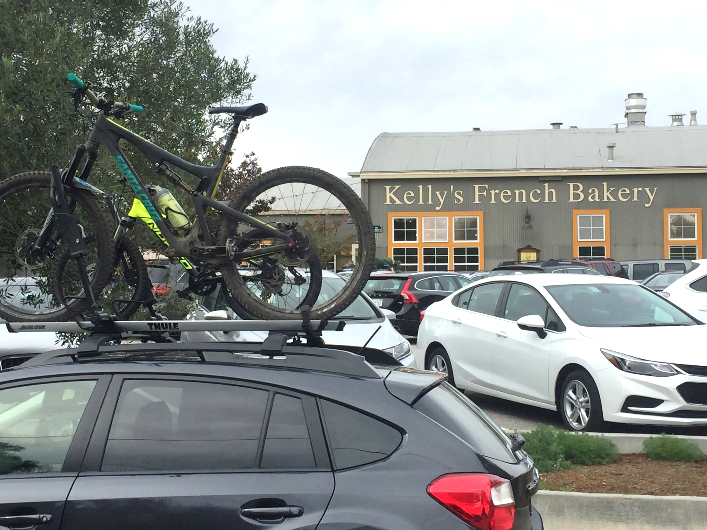
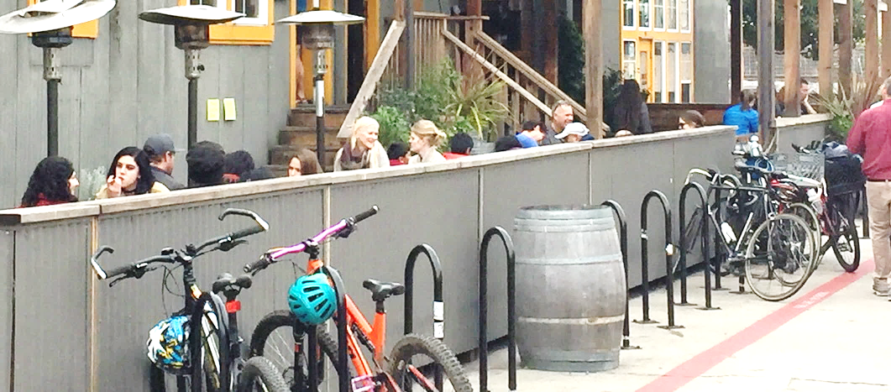

Slide 34
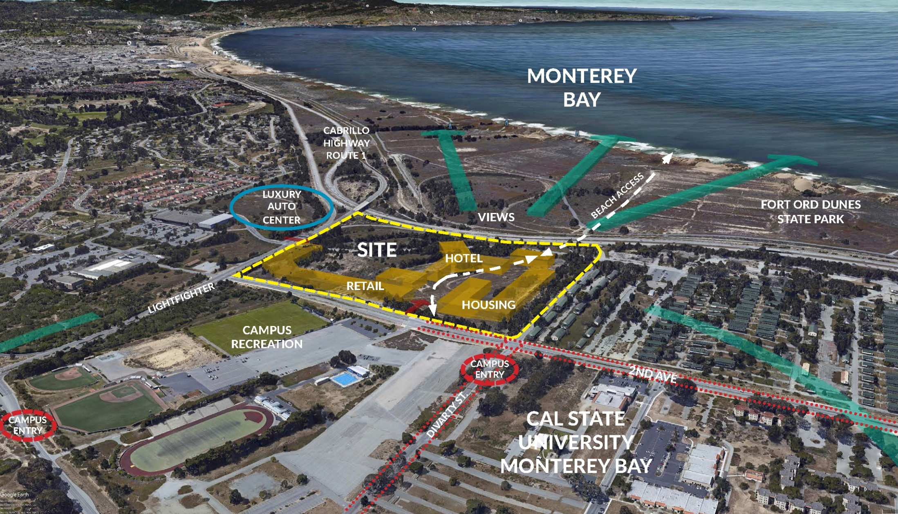

Slide 35
Organizations with whom the FORTAG team has met*
Government
  City of Marina
  City of Seaside
  City of Del Rey Oaks
  City of Monterey
  County of Monterey
  BLM
  US Army – BRAC
  US Army – Presidio
  State Parks
  State legislature
  Federal legislature
Other agencies and utilities
  FORA
  Transportation Agency for Monterey County
  Monterey Peninsula Regional Parks District
  Monterey-Salinas Transit
  AMBAG
  Cal trans
  State Department of Fish & Wildlife
  US Fish & Wildlife Service
  PG&E
  MRPWCA
  MCWD
  Cal Vet
Education
  CSUMB
  UCSC – Fort Ord Natural Reserve
  UCSC – MBEST
  Monterey Peninsula College (MPC)
  Chartwell School
  Monterey Bay Charter School
  York School
Developers, business, & private landowners
  Marina Community Partners (MCP)
  Chadmar Group (Marina Heights)
  Bruno family / Monterey Peninsula Engineering
  Monterey Downs
  Monterey Peninsula Properties (Del Rey Oaks)
  East Garrison
  Cypress Knolls
  Monterey County Hospitality Association
  Monterey Peninsula Chamber of Commerce
  Monterey County Convention & Visitors Bureau
Consulting firms
  Denise Duffy & Associates (DDA)
  Bellinger Foster Steinmetz (BFS)
  ICF International
  Dover Kohl Partners (DKP)
  Pathways for Wildlife
  Wood Rodgers
  Clifford Moss
  Raimi & Associates
  TJKM
Other organizations & businesses
  Central Coast Veterans Cemetery Foundation
  Sierra Club
  Big Sur Land Trust
  CA Native Plant Society
  Audubon Society
  FORT Friends
  Keep Fort Ord Wild
  Veterans Fort Ord Wild
  Sustainable Marina
  Sustainable Seaside
  Monterey Off Road Cycling Association
  Central Coast Cyclocross
  Sea Otter Classic
  Big Sur International Marathon
  Fort Ord Training Heritage Museum
  Rotary Club of Monterey
Total:
176 one-on-one meetings
  160 people
  69 organizations
*Or to whom we have given a presentation

Slide 36
FORTAG achievements to date
Transportation Agency for Monterey County (TAMC)
  Nov 2016 - $20 million in funding secured for FORTAG as a specifically-named component of $600M TAMC plan approved by super-majority of county voters (Measure X)
  Mar 2016 - TAMC Board approval (unanimous). FORTAG remains at $20M in a motion to amend the list approved in February.
  Feb 2016 - TAMC Board approval. FORTAG included at $20M on final list of regional projects to be funded by TAMC's transportation tax measure going to county voters in November 2016.
  Dec 2015 - FORTAG included on "early draft" list of projects authorized by TAMC Board for public review
  (listed under "Recreational Trails, including Fort Ord Rec Trail")
  Nov 2015: FORTAG on list of projects being considered by TAMC for funding through transportation tax measure for Nov 2016 ballot
  Aug 2015: TAMC Board unanimously adopted motion directing “staff to assist in finding funding sources for the project, provide more information on a possible TAMC role, and present funding and phasing ideas. directing staff to work toward FORTAG.”
Fort Ord Reuse Authority (FORA)
  Mar 2016: FORA Board of Directors unanimously approved a resolution in support of a Draft Trails Concept that mirrors the proposed FORTAG alignment
  Feb 2016: FORTAG alignment in the form of the FORA Trails Blueprint approved by FORA PRAC Committee to go to the FORA Board for approval
  May 2015: FORTAG used as starting point for FORA Trails Blueprint
  Mar 2015: FORTAG included in FORA’s draft Habitat Conservation Plan
  Jan 2015: FORTAG highlighted in introduction to Fort Ord Trails Symposium
Monterey County
  Mar 2015 to Aug 2015: FORTAG included in County’s draft trails plan for the FORHA area
City of Marina
  Nov 2014: Council unanimously adopted motion (after FORTAG presentation) to support and progress with concept of a 13-mile loop around Marina (i.e. the FORTAG northern loop
  Jan 2014: Council unanimously adopted motion to investigate feasibility of a trail & greenway from 8th St to Intergarrison Rd (a key FORTAG segment)
California State University Monterey Bay (CSUMB)
  Sep 2015 to Mar 2016: FORTAG included in draft CSUMB Master Plan illustrative maps
  ~Mar 2016: FORTAG referenced in Specific Plan for Monterey Bay Charter School
Letters and other public expressions of support
  Sam Farr
  Bill Monning
  CSUMB
  MPRPD
  State Parks
  BSLT
  East Garrison
  FORT Friends
  MORCA
  FFOW
  TAMC
  Monterey Bay Charter School
  Sea Otter Classic
  Big Sur International Marathon
  Sustainable Monterey County / Marina / Seaside / Carmel Valley

Slide 37
MCHA relevance
Be informed
Advocate for regional trails
at local government level
  Existing hotels:
  Add a day to your stay
  Future hotels, cafes etc
  Regionalize - Don’t let yourself become landlocked by local planning
  Market the idea that Monterey is a
  year-round destination.
  Monterey / Fort Ord trails are a year-round asset.

Slide 38
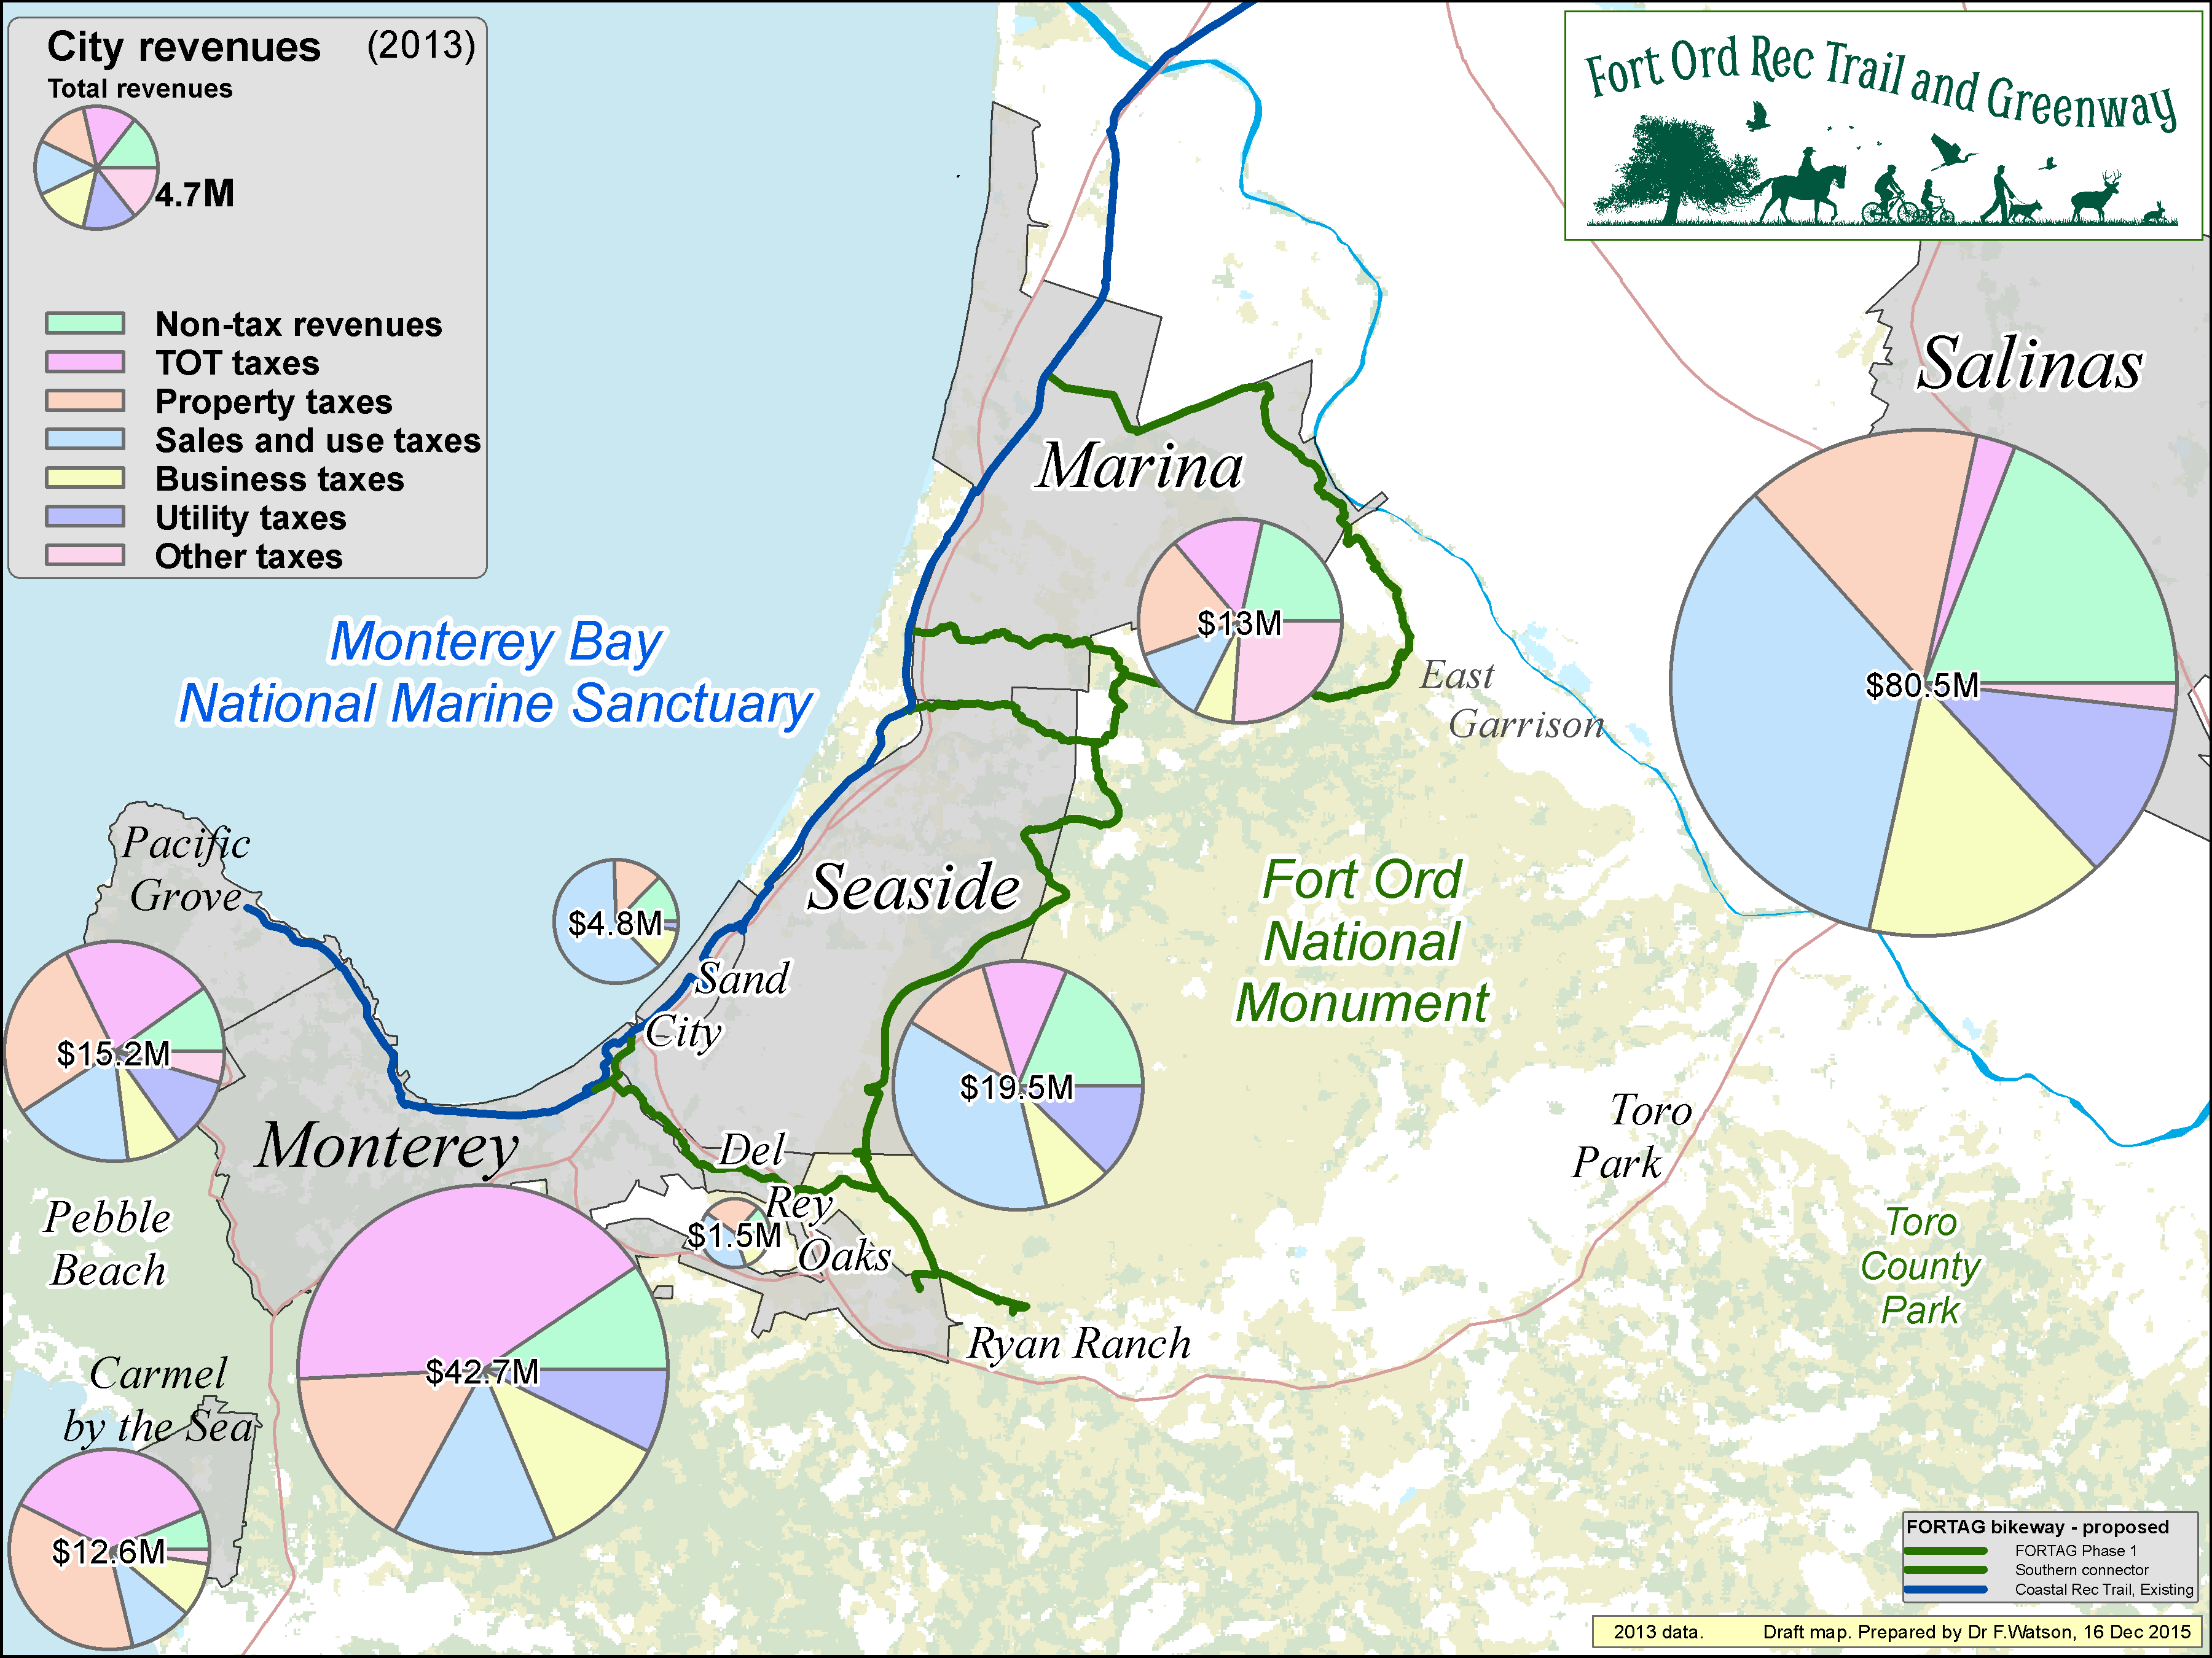

Slide 39
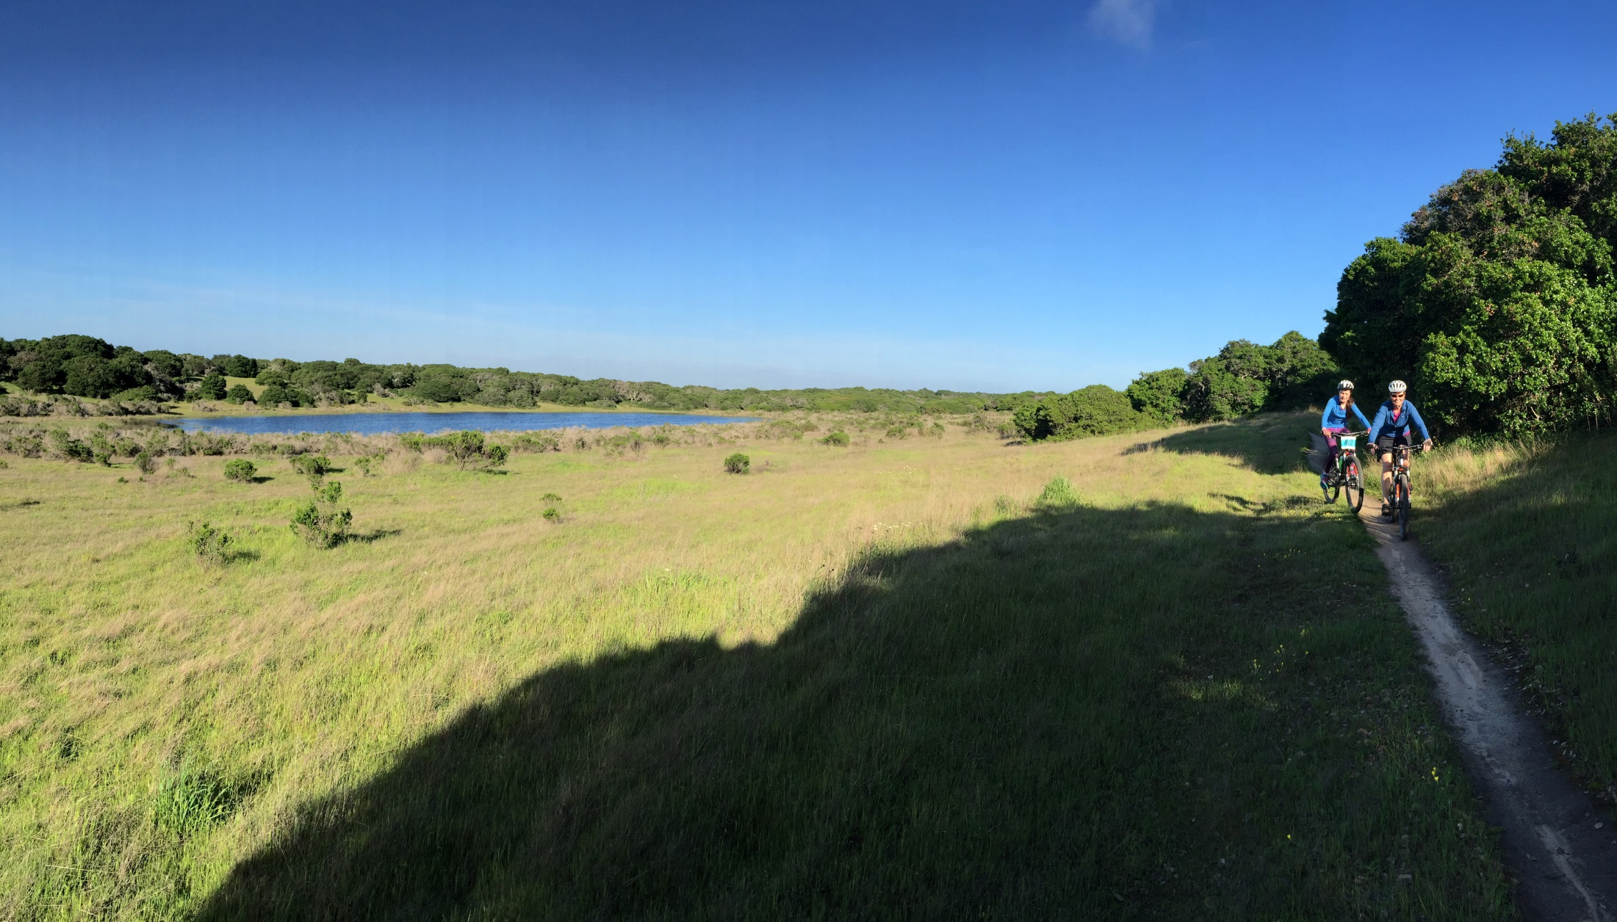
fortag.org
facebook.com/FORTAG
FORTAG will help people discover the destination of Fort Ord
*Formally: “The Monterey Bay Sanctuary Scenic Trail”

Slide 40
Final note:
If you happen to be shown in one of the photos in this presentation and either:
(1) want a copy of the photo, or
(2) want the photo to be removed from our outreach materials, please let us know.
fortag@fortag.org

